Slide 1


Welcome!
Annual Winter Meeting
Governor’s Workforce Development Board (GWDB) Minnesota Association of Workforce Boards (MAWB)
November 8, 2023

Slide 2
Call to Order
Laura Beeth
GWDB Chair
Com. Scott Schulte
MAWB Chair

Slide 3
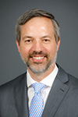
DEED Commissioner Matt Varilek Welcome

Slide 4
GWDB Business Meeting
Laura Beeth| Governor’s Workforce Development Board Chair

Slide 5
GWDB Business Meeting
September Minutes*
Chair’s Report*
GWDB 2024 Meeting Schedule*
Vice-Chair Role
Ad-Hoc State, Regional and Local Plan Review Committee
* Indicate Voting Items

Slide 6
GWDB 2024 Meeting Schedule
  Wednesday, February 28: 10 am – 1 pm Virtual Meeting to vote on final approval of the 2024-2027 WIOA Combined State Plan. Please note: Voting members must be present.
  Wednesday, June 12: 10 am - 2 pm In-Person Meeting
  September (Dates and Times TBD): In-Person Meeting the day after the Second Annual Workforce Summit in Greater Minnesota
  Wednesday, November 13 GWDB-MAWB Joint Winter Meeting: 10 am – 2 pm In-Person Meeting

Slide 7
MAWB Business Meeting
Commissioner Scott Schulte

Slide 8
MAWB Business Meeting
2024 Legislative State Platform and Federal Priorities

Slide 9
Sector Strategies in Colorado
GWDB-MAWB Joint Annual Winter Meeting
November 8, 2023
Lee Wheeler-Berliner, Managing Director

Slide 10
Introductions
Why sector strategies?
Colorado’s approach
Guiding principles and practices
Discussion
Agenda
Notes:
11:00-12:15

Slide 11
Acronyms to Know
R & D
Rip-off and Duplicate
SWIPE
Steal With Integrity, Pride, and Enthusiasm

Slide 12
Vision, Mission, and Values
Vision: Every Colorado employer has access to a skilled workforce and every Coloradan has the opportunity for meaningful employment, resulting in individual and statewide economic prosperity.
Mission: Enhance and sustain a skills-based talent development network that meets the needs of employers, workers, job seekers, and learners for today and tomorrow.
Values: Equity, agility, integration
Notes:
The vision and mission speak to both the “why” and the “what” of our work. While the vision lays out why we exist as an organization and choose to work hard at the tasks we undertake, the mission explains what we are actively doing to make that vision a reality.
The values are guidelines for how we do our work together, and they send the signal that realizing our vision will be meaningful only if we achieve it with a focus on three key things: Equity, Agility, Integration.
Equity points to the phrase “every Coloradan,” recognizing the data points we track tell different stories when we dig into subsets and groups. It acknowledges that prosperity is not a macro measurement, but a much more individual and community based concept that requires us to examine the unique needs of different populations in Colorado.
Agility speaks to the need to be responsive to shifts in the environment. In our work it emphasizes the need to support the training of individuals on the essential skills necessary in the 21st century workplace, and those that will be necessary in the next 15 years. Agility requires us to focus both on our current tasks and those yet to come, and demands that we conduct our business inside a framework that is ready to adapt, pivot, and redirect our energy as needed, when needed.
Integration acknowledges that our vision does not belong to only one sector. It isn’t just a “government vision” or a “business community vision,” and it can’t be achieved in isolation. It also highlights that the CWDC creates the most value when working at the intersection of business, government, and the nonprofit community, as well as at the intersection of education, economic development, and workforce development. By focusing on the integration of these forces we are able to create the energy and the coalition to make our vision a reality.
History if needed: The CWDC approved an updated vision, mission, and values at the January 2020 Council meeting. Discussion about a revised vision and mission started in May 2019 out of a desire from Council members to more closely examine the intent of these statements and ensure they reflect the current work and purpose of the CWDC. Conversations at the September 2019 and January 2020 Council meetings and with the CWDC Executive Committee resulted in the drafting and approval of this iteration. The updates made to these statements solidify the CWDC’s strategic focus for talent development in the coming years, make it clear that the success of our already strong network is dependent upon individual success, and that opportunity must be available to all populations in Colorado.

Slide 13
Why Sector Partnerships?
WIOA Section 101(d)(3)(D)
The development and expansion of strategies for meeting the needs of employers, workers, and jobseekers, particularly through industry or sector partnerships related to in-demand industry sectors and occupations;
WIOA Section 107(d)(4)(D)
To develop and implement proven or promising strategies for meeting the employment and skill needs of workers and employers (such as the establishment of industry and sector partnerships), that provide the skilled workforce needed by employers in the region, and that expand employment and career advancement opportunities for workforce development system participants in in-demand industry sectors or occupations.

Slide 14

Why an industry-led approach?
Industry-led means that firms have joined forces to identify and implement projects that they all believe are critical to the health and prosperity of their industry.
These businesses collaborate to grow their industry, provide job opportunities, and contribute to the region's economic stability.
  Sector Partnerships can inform public partners of their critical needs with one voice.

Slide 15
Sector Strategy v. Sector Partnership
Colorado implemented its Sector Strategy in 2005. The State has since expanded Sector Partnerships using the NextGeneration Sector Partnerships Model
  Promotes industry-driven alignment across economic development, workforce development, and education.

Slide 16
Definition: Next Gen Sector Partnership
Regional partnerships of business leaders within one industry, who work together with public partners from economic development, workforce development, education and training, and other community organizations, to address the shared workforce and broader competitiveness needs of their industry.
Operating Principles
Industry pull vs. program push
Shared table vs. owned by a single institution or system
Integrated response from education, workforce and economic development vs. one-off solutions

Slide 17
Background on Sector Partnerships
Sectors Summit: Accelerating Work-based Learning
Statewide Summit is convened. Focus is on experiential or work-based learning. Coincides with progress from the Business Experiential Learning Commission.
Sectors Summit: Growing the Talent Pipeline
Colorado hosts first Sectors Summit. First Next Gen Sector partnerships are launched.
First Sector Partnership Launched in healthcare
2007
2013
2022
2005
2014
2017
NGA Policy Academy
Colorado’s involvement leads to the creation of the Sectors Steering Committee. Sector partnerships exclusively focused on workforce. First Gen Sector Partnership Grants released in 2008.
Launch of the Colorado Talent Pipeline Report
NGA Policy Academy leads to creation of report and shared focus on sector partnerships. Sector Partnerships codified in law through SB 14-205
WildFig Evaluation
After over a decade of sector strategies in Colorado, Sectors Steering Committee calls for an external evaluation of state’s strategies.
Notes:
First sector partnership launched in 2005 in healthcare with the Wells Center.
Initially, partnerships were exclusively focused on workforce development. When Colorado launched next generation sector partnerships, they were intended to be driven by the priorities of business and industry identifying the priorities they most want to tackle together and craft their own solutions with support from public partners making them a go to shared table. As the number of sector partnerships has grown, the approach to implementing the model and impact has varied. A tension also exists between retaining the organic priorities of the regionally driven partnerships and engaging the partnerships in strategic priorities of the state and regions (like the expansion of work-based learning and apprenticeships, skills-based hiring and more.
SP’s in law-SB 14-205 https://static1.squarespace.com/static/57ebae4d5016e1191947196b/t/5c4a0cc47ba7fc5210151c25/1548356804474/SB14-205_0+%281%29.pdf
2015: Sectors Summits convene state and local stakeholders across business, education, workforce and economic development statewide. Shift to Next Gen sector partnerships expands focus from exclusively being on workforce to addressing competitiveness needs of sector.

Slide 18
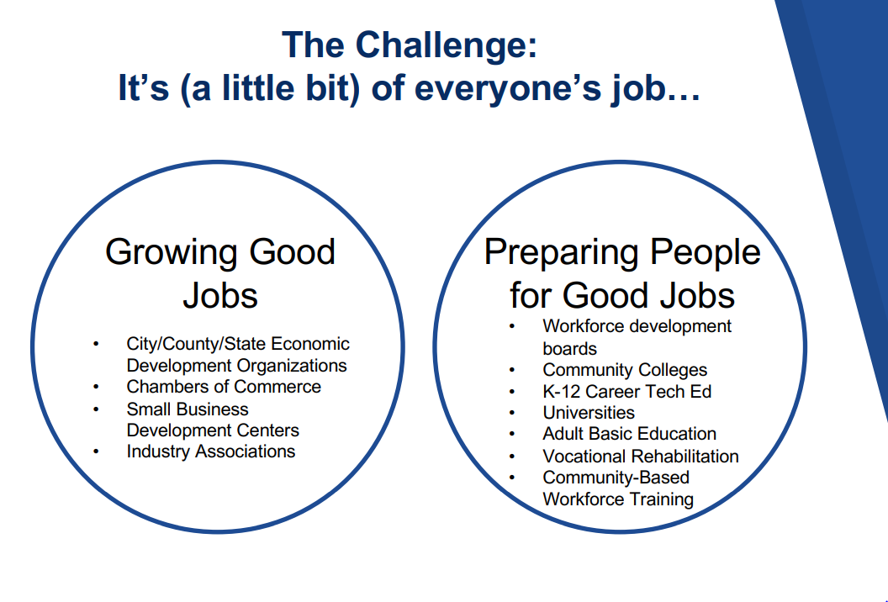
Why Next Gen Sector Partnerships?
GOAL:
Growing Good jobs for local people
Source: Institute for Networked Communities
Notes:
Why are sector partnerships an integral part of Colorado’s strategy?
Every community is after 2 goals: Growing good jobs for local people and preparing and connecting people with good jobs. This is a messy and complex need that we often silo out. Accomplishing these goals is not the job of a single entity. It’s a little bit of everyone’s job requiring new approaches to collaboration.
Lee, video includes useful messaging you can use from training: https://drive.google.com/drive/folders/1rWrqN-q6JmJI35fnlWaa6N9-Nzk1N9xc

Slide 19
Roles of the State and Local Boards
State
Regional & Local Partners
Provides a state-level framework to align programs and resources.
Proactively integrates sector strategies as a core way of doing business.
Utilizes a public-private steering committee that fosters business leadership.
Recognizes existing work and build upon regional differences and strengths.
Promotes promising practices working to grow and sustain public/private partnerships statewide and nationally.
Provides technical assistance and support to regions and industries.
Incentivizes partnerships developing innovative solutions to their local workforce needs
Convenes partnerships
Utilizes and customizes the sector partnership framework to drive action across regional system partners.
Proactively integrates industry-led sector strategies as a core way of doing business.
Builds a core team of public partners that foster support for business led priorities.
Recognizes the value of frameworks and sharing across the state while adapting for regional differences and strengths.
Utilizes Technical Assistance and shares promising practices with other regions and Industries.
Tests innovative solutions to regional and local workforce challenges

Slide 20
Sector Steering Committee Purpose
The purpose of the Sectors Steering Committee is to play an integral role in CWDC’s work by providing strategic guidance on how to best ensure that we remain an industry-led economic and talent development system in Colorado.
Strategic Value
Convene on a sustaining basis to set the direction of initiatives and programs that need to be industry-led in our state to drive alignment and scale across agencies and partners.

Slide 21
Committee Member Roles
Inform and Educate
Convene
Inform and educate
Advocate
Recommend
Convene business members from sectors with top jobs twice a year to discuss and advise existing sector strategies and talent pipeline efforts underway in Colorado.
Make strategic connections across key sectors strategies and support the industry-led work of CWDC.
Act as the voice of employers and local communities to help policy makers and education and training providers understand the needs, challenges and opportunities of businesses in Colorado.
Advocate for the flexible use of government monies to allow stakeholder use of innovative solutions to address employers’ talent development needs.
Guide CWDC’s sector strategy and industry-led approaches by informing strategy, suggesting funding allocations and identifying policy and procedure changes as needed to remove barriers or better support alignment to industry needs in Colorado.

Slide 22
Business Innovation Strategies Unit
Supports Sector Partnerships throughout the State of Colorado through a variety of means and mechanisms. Support / Resources include, but are not limited to:
Present current funding or resources to partnership
Present work-based learning programs
Connect partnership to State agencies, i.e. ODEIT, CDE, CDHE, DOLA, DORA and more
Provide opportunity to collaborate around strategies
An example of a recent partnership for local: Presented Work Based Learning Initiatives program to Northern Colorado, Manufacturing Partnership in November 2023

Slide 23

Local Sector Strategy Example
Aerospace Sector Partnership
The Aerospace Sector Partnership is an industry-led, workforce, education and economic development collaborative designed to meet the hiring, retention, and training needs identified by the Aerospace companies in the greater denver metro area.
Supporting Opportunity Now Grant Application and Innovative work around security clearance process
Partners Involved in the Sector Partnership:
Arapahoe/Douglas Works! Convener
3 Industry Chairs - Lockheed Martin, Astroscale and Centennial Software Solutions
Strong Industry Engagement - Blue Origin, Booz-Allen-Hamilton, York Space Systems, ULA, Boeing, Leidos, Northrup Grumman, Raytheon, Sierra Space, Ball Aerospace and NASA
State and Local Education (HE & K-12)
Colorado OEDIT
Local Economic Development
Municipalities
CDLE
Library System
Community Based Organization

Slide 24
Local Sector Strategy Example
The Greater Metro Denver Healthcare Partnership
The Greater Metro Denver Healthcare Partnership (Partnership) is an industry-led, workforce, education and economic development collaborative designed to meet the hiring, retention, and training needs identified by six of the largest hospital systems and ambulatory care facilities in the Greater Metro Denver area.
Partners Involved in Sector Partnership
Economic Development Partners:
Aurora Chamber of Commerce
Denver Office of Economic Development
Denver South Economic Development
Partnership
Adams County Economic Development
Association Partners:
Denver Area Healthcare Recruiters Association
Association of Operating Room Nurses
Colorado Center for Nursing Excellence
Business/Industry Partners:
Children’s Hospital Colorado
Centura Health System
Denver Health
HealthONE System
Kaiser Permanente
Lutheran/Exempla
University of Colorado Hospital
Workforce Partners:
Adams County Workforce Center
Arapahoe/Douglas Works!
Denver Office of Workforce and Economic Development
Jefferson County Workforce and Business Center
Colorado Urban Workforce Alliance
Education Partners:
Metro State University
Colorado Center for Medical Laboratory Science
Adams County Education Consortium
Arapahoe Community College
Front Range Community College
Area health Education Center

Slide 25
Local Sector Strategy Example
The Greater Metro Denver Healthcare Partnership Continued:
Strategies Created for Success
Subject Matter Experts from Business/Industry drive the occupations to focus on training and the most critical occupations:
Nursing, Medical Technologist, Medical Laboratory Technician and Surgical Technician
Registered Apprenticeships:
  Medical Assistant Apprenticeship Program
  Medical Laboratory Technician Apprenticeship Program
Vetted Data – Neutral/Objective Discussion
Industry Profile
Regional Growth Projections
Top Regional Employers
Competitive Wage Analysis
Saturation Rates
Skills Gap
Critical Occupations

Slide 26
A Snapshot of Sector Partnership Success
Colorado Tree Care SP: First cohort of Arborist Journeyworkers graduated from the apprenticeship program at Front Range CC in 2022.
South Central Tech SP: Creation of a co-working space and incubator and Pax8’s move to Fremont County The Workforce Innovation.
Mesa County Manufacturing SP: Program created in 2019 provides base-level training for job seekers and up-scaling skills for current workers, serving up to 200 students a year.
Notes:
Northern Colorado sector partnership Video of https://vimeo.com/723453384
In the communities who have most successfully integrated the sector partnership approach it has shifted the way they do business and created a comprehensive regional approach to economic and workforce development
Other examples of sector partnership success
In 2019 the South Central Tech Sector Partnership opened Emergent Campus, an 80,000 square foot coworking space located in the historic former Florence High School in Florence, Colorado. Emergent Campus serves as a space for tech incubation, trainings, offices, events, and even living quarters, centered on a "work, live, play" community model. This played a crucial role in encouraging the company Pax8 to open a remote office in Florence as part of their rural engagement strategy. The sector partnership has played an important role in developing the tech economy in their region
The Greater Metro Denver Healthcare Partnership has collaborated with industry and education partners to create several recognized apprenticeships, which allow firms to grow their own staff while training them. The partnership's apprenticeship model continues to benefit students and job seekers, as each cohort has provided jobs and helped address significant needs for the region's healthcare industry caused by COVID-19.
The Metro Denver Retail Sector Partnership in collaboration with the Colorado Restaurant Foundation and Dynamic Learning, is offering industry credentials to workers who have been laid off or furloughed as a result of COVID-19.

Slide 27
Key Performance Indicators
Survey methodology utilized
Business members and conveners asked to respond
Impacts examined on businesses and on jobseekers
Notes:
Upon completion of the KPI, results are collected and analyzed. These are then presented in three primary formats:
1. Talent Pipeline Report
2. Individual report to each partnership
3. Statewide Community of Practice webinar presentation

Slide 28
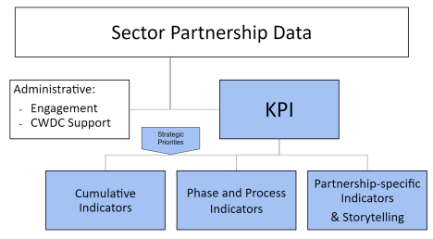
Key Performance Indicators
Notes:
Cumulative indicators are tracked across all partnerships and cover the majority of identified strategic priorities for sector partnerships.
Phase and Process Indicators ask questions that demonstrate the status of the partnership and its steps towards sustainability.
Finally, the Partnership-specific Indicators and Storytelling provide the opportunity for partnerships to report on what is important to them but may not be comparable across all industries. It also opens for qualitative responses, providing information on success stories and barriers in the partnership.

Slide 29
KPI Examples
Impact on Businesses
82% have businesses that have developed new or enhanced ideas for new products and/or markets
91% have businesses that have found support in finding employees with the skills and experiences their business needs
82% have businesses that have developed new recruitment practices
Impact on Jobseekers and Students
71% increased student/jobseeker awareness of training/education programs.
62% experienced increased program alignment across secondary, post-secondary, and/or workforce programming.
67% enhanced existing or developed new training/education program(s).

Slide 30
Communities of Practice
Regular calls to provide information, support, and facilitated discussion
Statewide
Industry Specific
  Healthcare
  Manufacturing
  Multi-Industry

Slide 31
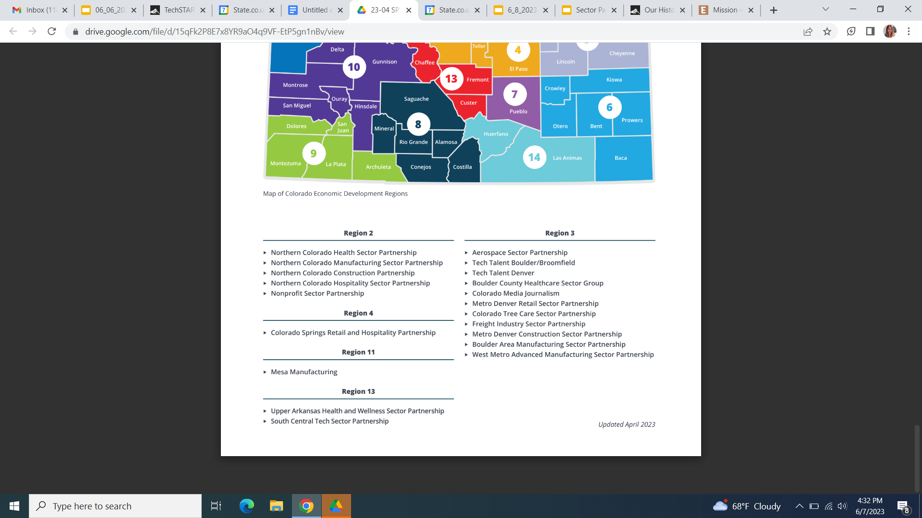
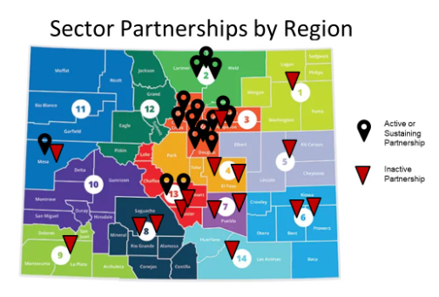
Where are we now?
25 Active or Sustaining Sector Partnerships

Slide 32
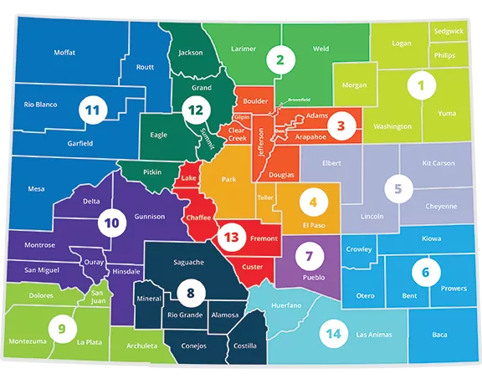
Recent 2023 Launches
Region 3
  West Metro Construction
  Boulder Healthcare
  Boulder Food, Beverage & Hospitality
Regions 4, 7, 13
  Southern Colorado Healthcare
Region 13
  Early Childhood Education

Slide 33
2023 - 2024 Explorations
Region 1
  Manufacturing - re-launch
Region 2
  Financial Services
Region 3
  Healthcare (with Behavioral Health focus)
Region 4
  Construction
Region 6
  Healthcare, Manufacturing, Agriculture
Region 8
  Healthcare
Region 9
  Healthcare, Building Trades
Region 11
  Clean Tech, Agriculture
Region 13
  Agriculture / Ag-Tech
Region 14
  Manufacturing

Slide 34
















Sector Strategies (87% critical industries)
Advanced Manufacturing
4 active/4 inactive sector partnerships
CAMA, Manufacturer’s Edge
Financial
0 sector partnerships
Colorado Bankers Association
Foundation Industries
Aerospace
1 active/0 inactive sector partnerships
COS pace Business Roundtable; CO Space Coalition
Food & Ag
1 inactive sector partnership
Education
1 active/2 inactive sector partnerships
EPDC, CEA
Bioscience
0 sector partnerships
Colorado Bioscience Association
Health & Wellness
3 active/ 7 inactive sector partnerships
Colorado Health Association (CHA)
Retail
3 active, 2 inactive sector partnerships
CRA;CHLA.
Creative Industries
1 active sector partnership
Infrastructure Engineering
2 active, 0 inactive sector partnership
AGC CO; HBA; CCA; Bldg & Construction Trades Council;
Misc
Nonprofit 1 active
No partnerships
Defense
Bioscience
Financial services
Defense
0 active sector partnerships
Technology & Information
3 active sector partnerships
Colorado Technology Association
Electronics
0 sector partnerships
Colorado Photonics Industry Association
Tourism & Outdoor Rec
2 inactive sector partnerships
CRA;CHLA.; Outdoor Industry Assoc.
Energy & Natural
1 active/0 inactive sector partnership (tree care)
CO Cleantech; CO Oil and Gas.; Tree Care Industry.
Transportation & Logistics
1 active sector partnership
Last updated Oct.2023
Notes:
16 industries of focus in Colorado. 14 of them provide liveable wages and high projected hiring. 2 Industries (education and retail) support training for other industries, have significant shortages and are necessary for economic health and growth in Colorado. The focus on these industries is consistent across CDLE, OEDIT and CCHE.

Slide 35
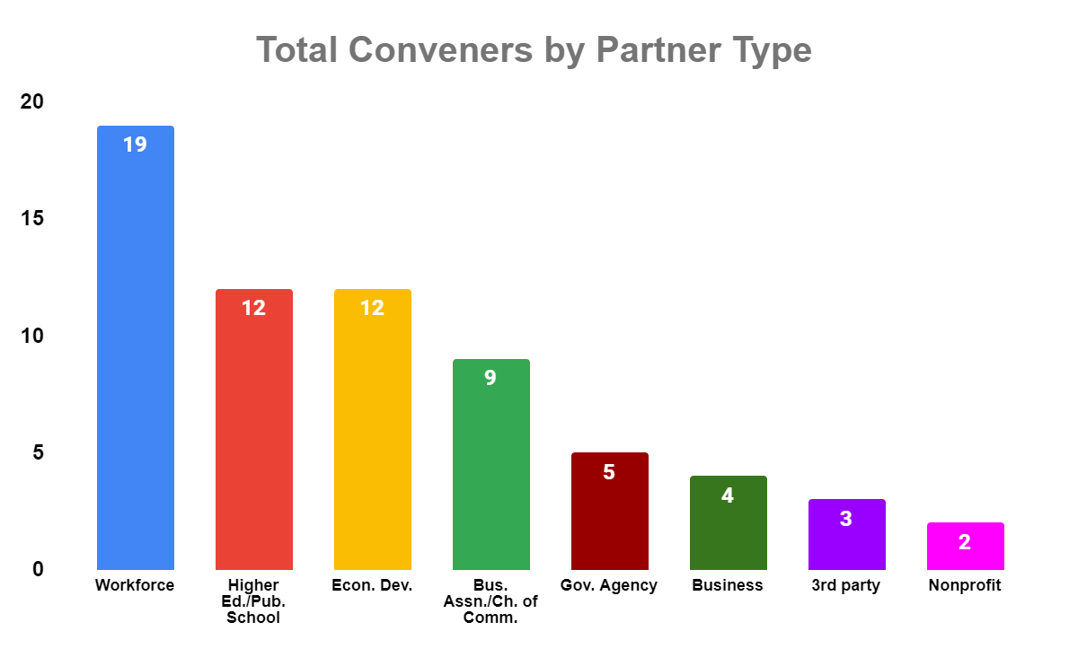
Sector Partnership Conveners by Type
Notes:
Conveners serve as the backbone support for sector partnerships. The role is staffed by a variety of different organizations in Colorado as indicated above. Eleven out of 15 sector partnerships that remained active throughout the pandemic were staffed by multi-convener teams representing more than one organization.
Staff from the public workforce system makes up a majority of sector partnerships. This is in part indicative of the fact that workforce is required to engage in sector strategies as a component of our WIOA plan. WIOA is the federal legislation that provides the primary guidance and financial resource for much of the work carried out in our public workforce system. There are many conveners on the call who received grants to organizations outside of workforce to convene sector partnerships. This is no way indicative of concerns with workforce convening, but demonstrates interest of other organizations to engage, particularly chambers of Commerce
Of the 11 stimulus grants for conveners issued by our office:
4 went to workforce (Eastern sub-area, tri-county, southwestern sub area, Southern Colorado (Pikes Peak/pueblo)
4 went to Chambers of Commerce (Ft. Collins Chamber, Boulder Chamber, Arvada Chamber, Pagosa Springs Chamber)
2 to industry associations- CTA, Press association
1 to Ec dev.- Fremont Economic Development Corporation

Slide 36
Key Considerations
State provided resources include money, knowledge, support, supplies
  web sites
  training
  facilitation tools
Local implementation critical to Colorado’s model

Slide 37
Discussion

Slide 38
Thank you!
lee.wheeler-berliner@state.co.us
www.coworkforcecouncil.org

Slide 39
Break

Slide 40
WIOA Updates: Titles I & III
DEED Staff

Slide 41
Minnesota Combined State Plan - Title I
WIOA Adult & Dislocated Worker Programs
Rita Apaloo | Grants Specialist Coordinator
Dislocated Worker & Federal Adult Programs

Slide 42
Targeted Populations: WIOA Dislocated Worker (DW)
Citizenship or work authorized, and Selective Service Compliance
One or more of the following six (6) categories (WIOA sec. 3(15)):
  Individual or Small Layoff
  Mass Layoff or Permanent Closure
  Self-Employed
  Displaced Homemaker
  Military Spouse
  Member of U.S Armed Forces

Slide 43
Targeted Populations: WIOA Adult
Citizenship or work authorized
Selective Service Compliance
18+ years of age
Priority of service observed
  Veterans and spouses
  Low income
  On public assistance
  Basic skills deficient
Notes:
WIOA establishes a priority requirement with respect to funds allocated to a local area for adult employment and training activities. American Job Center staff, when using WIOA Adult funds to provide individualized career services and training services, must give priority to recipients of public assistance, other low-income individuals, and individuals who are basic skills deficient. Under WIOA, priority must be implemented regardless of the amount of funds available to provide services in the local area. In addition, veterans receive priority of service in all DOL-funded employment programs.

Slide 44
WIOA Adult Funding and Performance
WIOA Based Performance Indicators | SFY 2018 | SFY 2019 | SFY 2020 | SFY 2021 | SFY 2022
Number served | 1,629 | 1,547 | 1,692 | 1,511 | 1,660
2nd Quarter employment rate | 82.9% | 82.9% | 82.5% | 74.0% | 69.7%
4th Quarter Employment rate | 82.9% | 82.4% | 79.0% | 71.9% | 67.8%
Median Earnings (2nd Quarter) | $7,883 | $7,680 | $7,819 | $8,232 | $8,758
Credential rate | 77.7% | 79.8% | 75.7% | 77.1% | 72.2%
Measurable Skill Gains (baseline measure) | 41.3% | 59.6% | 56.2% | 69.2% | 68.0%
Funding Level by Fiscal year
Fiscal Year | Funding Level
SFY2018 | $7.3M
SFY2019 | $6.2M
SFY2020 | $7.2M
SFY2021 | $6.9M
SFY2022 | $9.1M
Achieving Equity
 | SFY 2018 | SFY 2019 | SFY 2020 | SFY 2021 | SFY 2022
Communities of Color | 34.1% | 39.1% | 41.6% | 41.6% | 49.6%
Individuals with Disabilities | 13.9% | 13.3% | 14.4% | 14.0% | 13.6%
Veterans | 2.8% | 3.4% | 2.5% | 2.0% | 2.2%
Women | 64.7% | 61.0% | 59.9% | 59.9% | 60.8%

Slide 45
WIOA Dislocated Worker Funding & Performance
WIOA Based Performance Indicators | SFY 2018 | SFY 2019 | SFY 2020 | SFY 2021 | SFY 2022
Number served | 9,701 | 8,624 | 7,960 | 6,791 | 5,900
2nd Quarter employment rate | 83.5% | 84.6% | 85.0% | 80.9% | 77.4%
4th Quarter Employment rate | 82.5% | 82.8% | 84.0% | 78.7% | 79.9%
Median Earnings (2nd Quarter) | $11,496 | $12,504 | $11,357 | $12,172 | $13,911
Credential rate | 76.5% | 71.3% | 78.8% | 79.2% | 79.9%
Measurable Skill Gains (baseline measure) | 38.8% | 61.7% | 75.8% | 79.4% | 86.8%
Funding Level by Fiscal Year
Fiscal Year | Federal funding | State Funding
SFY2018 | $7.7M | $29M
SFY2019 | $8.7M | $21.3M
SFY2020 | $7.3M | $24M
SFY2021 | $8.6M | $31.3M
SFY2022 | $10.3M | $21.3M
Achieving Equity
 | SFY 2018 | SFY 2019 | SFY 2020 | SFY 2021 | SFY 2022
Communities of Color | 17.7% | 17.4% | 15.6% | 26.0% | 32.4%
Individuals with Disabilities | 6.2% | 6.2% | 6.2% | 6.3% | 8.0%
Veterans | 5.8% | 5.5% | 4.9% | 4.5% | 4.5%
Women | 50.1% | 51.9% | 50.6% | 46.6% | 46.9%

Slide 46
DEED’s Goals
Our four-year goals, leading us to 2027, are rooted in the mission and values of our agency.
Equity in our economy – making transformative change to eliminate inequality in our economy.
Workforce and talent attraction – growing our workforce and creating opportunity for every jobseeker.
Economic dynamism – creating a dynamic environment for business growth, from start-ups to expansions.
Notes:
We all do better when we all do better

Slide 47
2023-2024 Objectives
Empower Minnesota to create an economy rooted in equity - across every race, identity and ability.
Drive growth that puts Minnesota at the forefront of innovation in technology, high-tech manufacturing, and health & wellness.
Meet the moment for Minnesota’s historic workforce shortages, with collaborative efforts towards high-wage jobs with strong growth potential.
Notes:
Each year, DEED (as an agency) chooses OKRs that cross-divisional teams work together to achieve.

Slide 48
Vision and Purpose of WIOA DW and Adult
Provide employment and training services to:
  Helps workers get back to work as quickly as possible and overcome barriers to employment
  Increase employment retention, earnings, and occupational skill attainment

Slide 49
Adult & DW 2024-2027 Goals, Priorities and Strategies
Implement robust program evaluation system
Increase Co-enrollment
Strengthen Partnerships
Streamline Business Engagement
DEIA/Equitable access to workforce development system
Encourage innovation

Slide 50
Coordination with Stakeholders
  Governor’s Workforce Development Board (GWDB)
  Local Workforce Development Boards (WDBs)
  Office of Public Engagement/Office of New Americans
  Dislocated Worker Service Providers
  Other workforce development service providers
  Minnesota’s Office of Higher Education
  Credential Engine – is a non-profit whose mission is to map the credential landscape with clear and consistent information, fueling the creation of resources that empower people to find the pathways that are best for them.
  National Skills Coalition - is a nonprofit organization that advocates for a national commitment to skills training and an inclusive economy.
  U. S. Department of Labor (DOL) – Partnering on bi-monthly national webinars to strategize program evaluations that drive policy change and present state evaluations for other states to learn how to it.

Slide 51
Thank You!
Dislocated Worker & Federal Adult Programs
Leadership and Staff
Nancy Omondi Dislocated Worker and Federal Adult Programs Director | Rita Apaloo Grants Specialist Coordinator
Lensa Idossa Program Manager | Sou Thao Grants Specialist Senior
Amy Carlson State Program Administrator Coordinator | Frederick Nah Grants Specialist Senior
 | Christine Dowie Grants Specialist Senior

Slide 52
DEED WIOA Youth Programs Overview
DEED Office of Youth Development
November 2023

Slide 53
Program Staff
Kay Tracy, Director, Kay.Tracy@state.mn.us
651-259-7555
Cory Schmid, Program Coordinator, Cory.Schmid@state.mn.us 651-259-7541
Ahmed Mohidin, Program Coordinator, Ahmed.Mohidin@state.mn.us 651-259-7515
Lynn Douma , Program Coordinator, Lynn.douma@state.mn.us 651-259-7536

Slide 54
Workforce Innovation and Opportunity Act (WIOA) Youth Formula Grant Program
The Workforce Innovation and Opportunity Act Youth Formula Grant program provides comprehensive employment and training services to opportunity youth, including (but not limited to) work-based learning, an introduction to career pathways, attainment of recognized credentials and support services.
WIOA Youth participants are at-risk youth ages 16-24 who are not attending any school, and in-school youth ages 14-21 who are low-income and at-risk.

Slide 55
WIOA Youth Services Provision
WIOA Youth Services are provided through local Workforce Development Boards and Youth Committees and include: tutoring, study skills training, and dropout recovery and prevention; alternative secondary school services; paid and unpaid work experiences; occupational skill training; education offered with workforce preparation activities and training; leadership development activities; supportive services; adult mentoring; follow-up services; comprehensive guidance and counseling; financial literacy education; entrepreneurial skills training; labor market and employment information about in-demand industry sectors/occupations; and activities helping youth prepare for and transition to post-secondary education and training.

Slide 56
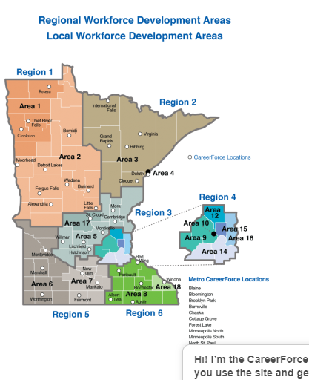

Slide 57
Barriers to Self-Sufficiency
All youth served in both Federal and State funded youth programs at DEED often face multiple barriers to self-sufficiency including:
Economically disadvantaged;
Pregnant or parenting youth;
Youth with limited English proficiency;
Potential (or actual) secondary school dropouts;
Youth offenders;
Public assistance recipients;
Youth with disabilities (including learning disabilities);

Slide 58
Barriers to Self-Sufficiency, continued
All youth served in both Federal and State funded youth programs at DEED often face multiple barriers to self-sufficiency including:
Chemically dependent youth or children of drug or alcohol abusers;
Homeless or runaway youth;
Youth with basic skills deficiency;
Youth with an educational attainment of one or more levels below grade level appropriate to age; or
Foster child/aged out of foster care

Slide 59
Performance Outcome
Measure | SFY 2019 |  | SFY 2020 |  | SFY 2021 |  | SFY 2022 |  | SFY 2023
 | Plan | Actual | Plan | Actual | Plan | Actual | Plan | Actual | Plan | Actual
Number Served | - | 2,305 | - | 2,561 | - | 2,422 | - | 2,476 | - | 2,451
Employment Education or Placement Rate - 2nd Quarter after Exit | 66.0% | 79.5% | 67.0% | 79.4% | 76.0% | 67.5% | 75.0% | 68.8% | 68% | 75.5%
Employment Education or Placement Rate – 4th Quarter after Exit | 62.5% | 76.5% | 62.5% | 79.6% | 74.0% | 70.7% | 73.0% | 71.4% | 69% | 76.5%
Credential Attainment Within 4 Quarters after Exit | 47.7% | 65.9% | 47.7% | 65.9% | 62.5% | 53.2% | 62.0% | 63.5% | 62% | 52.8%
Median Earnings - 2nd Quarter after Exit | Not Negotiated | N/A | Not Negotiated | N/A | $3,700 | $4,872 | $3,700 | $4,542 | $4,000 | $5,440
Measurable Skills Gain | Not Negotiated | 45.6% | Not Negotiated | 50.8% | 49.0% | 49.0% | 49.0% | 42.9% | 41% | 56%

Slide 60
Achieving Equity
Demographic | SFY 2019 | SFY 2020 | SFY 2021 | SFY 2022 | SFY 2023
Youth from communities of color | 59% | 62% | 75% | 74% | 76%
Youth with disabilities | 38% | 38% | 34% | 38% | 40%
Female youth | 54% | 55% | 56% | 54% | 52%

Slide 61
Achieving Equity Cont..
Youth served include those with a disability (40%); public assistance recipients (31%); system-involved youth - foster youth or juvenile offenders (15%); homeless or runaway youth (16%); and youth of color (76%).
mn.gov/deed

Slide 62
Funding Source and Allocation
Funding Source | SFY 2019 | SFY 2020 | SFY 2021 | SFY 2022 | SFY 2023
Federal Funds | $8.61M | $7.73M | $7.05M | $9.22M | $8.9M

Slide 63


DEED’s
CareerForce Division
_{WIOA Title III}
Employment Service Program funded by the Wagner Peyser Act

Slide 64

Wagner Peyser Act – WIOA Title III
The Wagner-Peyser Act, signed into law in 1933
  Established a nationwide network of public employment service offices called “Job Service” in Minnesota and most other states.
  Employment Service Program is a core program under the Workforce Innovation and Opportunity Act (WIOA)
    Basic purpose is to improve the functioning of the nation’s labor markets by bringing together individuals seeking employment and employers who are seeking workers.
    Referred to as Title III Employment Service Program funded by the Wagner Peyser Act
Notes:
Mike

Slide 65
Employment Service Program
Part of the CareerForce Division of DEED
Allows for operation of the Job Service team, programs and services
Each state must administer a public labor exchange system
  Capable of providing services to all employers and career seekers
  Special emphasis on:
    Veterans
    Unemployment Insurance (UI) Applicants
    Migrant and Seasonal Farmworkers
Services must be made available through
  Self-service
  Facilitated self-help service
  Staff-assisted service delivery methods
Notes:
Mike

Slide 66
Employment Service Program – Key Services
Available to anyone legally able to work in the United States
Facilitates access to services and resources that help businesses attract and retain good workers.
Connects Unemployment Insurance applicants, Veterans and others to available programs, services and good career opportunities.
Operates as an enterprise to offer consistent and high-quality services, leverage resources, improve efficiencies, and build capacity.
Collaborates with our state and local partners to improve services to customers and minimize duplication.
Uses the most effective tools and latest data to serve our customers and match them to careers.
Works collaboratively with local partners and service providers to maintain awareness of all programs and services for our customers.
Notes:
Art

Slide 67

Employment Service Program
MN DEED delivers key services to job seekers and businesses through Job Service.
The focus of all services is to help job seekers find work and help employers find and retain qualified employees.
All services are available through
Minnesota’s statewide network
of CareerForce locations
Notes:
Art

Slide 68
Thank You!
Mike Lang
Interim Director, CareerForce
Mike.Lang@state.mn.us
651-259-7583
Art Larsen
Job Service Field Director
Arthur.Larsen@state.mn.us
218-302-8404
CareerForce Information & Assistance Line
CareerForce@state.mn.us
651-259-7500
Notes:
Thank you for joining us today
Here's our contact info if you have questions!

Slide 69
QUESTIONS OR FEEDBACK?

Slide 70
Lunch

Slide 71
WIOA State, Regional and Local Plan Guidance
Katie McClelland | GWDB Director

Slide 72
Guidance Overview
An overview of State Plan Requirements and Organization
Strategic Vision, Goals and Strategies for 2024-2027
State, Regional, and Local Plan Timeline
State Plan Administrator Assignments
Regional and Local Planning Guidance
Regional Plan Template
Local Plan Template
WIOA Guidance
Regional and Local Plan Attachment Templates

Slide 73
State Plan Requirements
How the State Plan Vision, Goals and Strategies will be implemented by their programs;
Promising practices from the previous 4-year plan will your program be expanding on, including the data or empirical evidence used to inform this decision; and
What areas described in your last state plan contribution you will not continue to pursue, including the data or empirical evidence used to inform this decision.
How is your program aligning programmatic activities with state or federal investments in the Bipartisan Infrastructure Law (BIL), the Creating Helpful Incentives to Produce Semiconductors (CHIPS) and Science Act, and the Inflation Reduction Act (IRA) (collectively referred to as Investing in America (IIA))?

Slide 74
WIOA State, Regional and Local Plan Vision & Goals 2024-2027
Interagency and Local Coordination: shared goals, maximizing efficiency and coordination of workforce funding and programs
Sector Partnerships: Create/expand workforce programs and career pathways with embedded work-based learning or on-the-job training, including Registered Apprenticeships, focused on closing gaps in participation and representation
Innovative Service Delivery: For a more inclusive, equitable, accessible, and proactive workforce system to serve all Minnesotans responding to changing nature of work, emerging technology, changing labor market demands, and shifting demographics

Slide 75
Plan Timeline
December 8: Due date for first drafts of each of the State Plan sections
By the end of December 2023: State Plan submitted to GWDB Executive Committee and GWDB State Plan special committee
January 15, 2024: State Plan submitted for Governor's Review and posted for 30-day Public Comment Period
​​​​​​​January 15 - February 15, 2024: Staff review public comments and feedback from Governor’s Office when available
January 31, 2024: Subsequent Designations and Board Certifications for Local Workforce Development Areas due
February 17-27, 2024: Staff incorporate any final changes needed from Governor’s Office or Public Comment
February 28, 2024: Special Virtual GWDB Meeting to Approve State Plan
March 4, 2024: WIOA 2024-2027 State Plan submitted to US DOL. The WIOA Combined State Plan for 2024 must be submitted to US DOL via the WIOA State Plan Portal with federal review/approval to be completed by June 2, 2024
May 6, 2024: Local and Regional Plans due
May 6 – August 1: GWDB Local and Regional Plan Special Committee review and provide feedback or suggested modifications
August 2, 2024: All Local and Regional Plans receive final determinations

Slide 76
Questions?

Slide 77
Minnesota’s Job Quality Academy Initiative: Panel and Discussion

Slide 78
Discussion Questions
  For the employers in the room, how does this topic resonate with you in terms of a talent attraction and retention strategy?
  What are some examples of best practices in raising job quality you have seen?
  How can we keep the worker voice front and center in this work?
  What are the challenges in implementing the eight “Good Jobs” principles?

Slide 79
Innovative Service Delivery

Slide 80
WIOA State Plan Goal #3: Innovative Service Delivery
Create a more inclusive, equitable, accessible, and proactive workforce system to serve all Minnesotans, preparing employers and the current and emerging workforce for the changing nature of work including new and emerging technology, changing labor market demands, and for the state’s shifting demographics, including our new Minnesotans.

Slide 81
Discussion Questions
Given the variety of needs and service delivery preferences among jobseekers and employers throughout the state, what are some ideas to best serve customers and help them meet their goals?
What partnerships are particularly important to innovative service delivery, thinking about helping both jobseekers and employers?
What can the GWDB, MAWB, or the state do—or provide—to help support innovative service delivery efforts?

