Slide 1
Foreign Labor Certification
H-2A Housing Inspections
Mary Garcia
Foreign Labor Certification Coordinator
CareerForce Systems, MN DEED

Slide 2
H-2A Housing Inspections
Required for H-2A Temporary Employment Certification
Federal Regulations
20 CFR 653.502
20 CFR 654.400-417
29 CFR 1910.142
Approved Housing Inspection valid for 1 year from date of inspection
Notes:
Karen talks

Slide 3
H-2A Housing Inspections: Process
Process:
- Employer / agent files application for Temporary Employment Certification with OFLC (Office of Foreign Labor Certification).
- State FLC Staff reviews application to determine if the housing is:
new or previously inspected, and when
owned or rented
publicly rented
- H-2A Housing Inspections must be approved (pass with no deficiencies) at least 32 days before the “start date of need”.
Notes:
Karen talks

Slide 4
H-2A Housing Inspections: New Employers
New employers are contacted right away via email, and receive:
Housing Inspection Guide
Lists what they need to have in place prior to inspection
Room Measurement Form
Document detailing size of major rooms
Employer completes the form and returns to State FLC Staff
H-2A Employee Rights Poster (English & Spanish)
Required to be placed in the housing

Slide 5
H-2A Housing Inspections: Forms
Forms:
Room Measurement Form
Form ETA 338
Checklist
20 CFR 654.404-.417 “ETA” (for housing built before April 3, 1980)
29 CFR 1910.142 “OSHA” (for housing built on/after April 3, 1980)

Slide 6
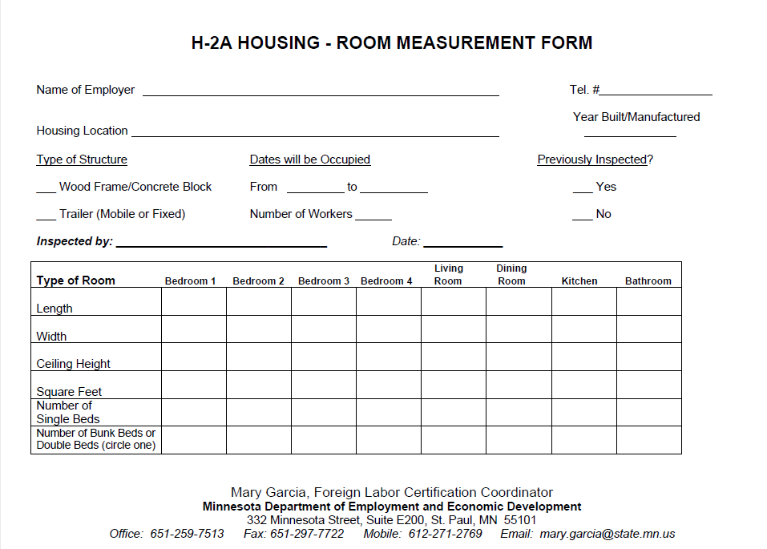
H-2A Housing Inspections: Room Measurement
Room
Measurement
Form

Slide 7
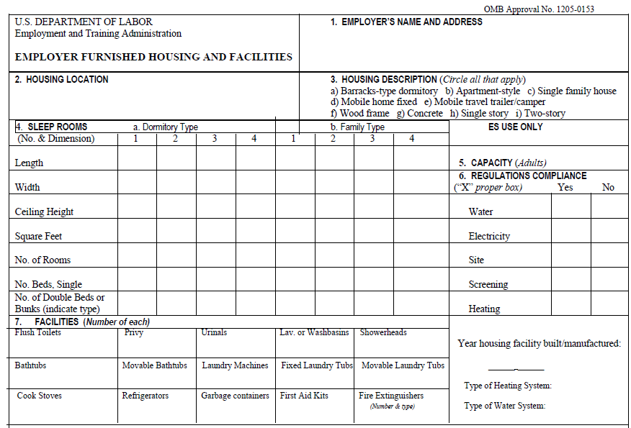
H-2A Housing Inspections: Form ETA
Form ETA 338
Items 1-7

Slide 8
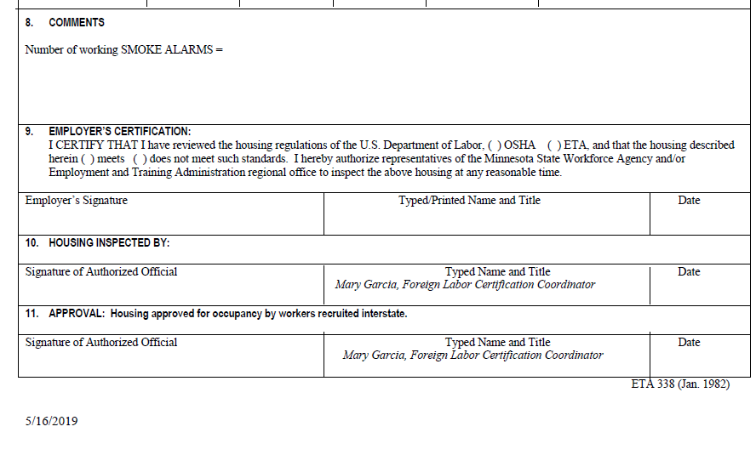
H-2A Housing Inspections: Form ETA, part 2
Form ETA 338
Items 8-11

Slide 9
H-2A Housing Inspections: Housing Photos
Photos of Housing:
A. Outside of dwelling:
_____all sides of a house, trailer, camper, or bunkhouse
_____outside entrance of an apt. building
_____Porch
_____Deck
B. Each interior room that workers will have access to:
_____Living Room
_____Kitchen
_____Dining Room
_____Bedrooms
_____Bathrooms
_____Hallways
_____Stairs
_____Family/Rec Room
_____Basement
_____Laundry Area
_____Garage
C. Safety Equipment:
_____First Aid Kit(s)
_____Fire Extinguisher(s) (showing Front of device/Gauge & Data Plate)
_____Smoke Alarms
_____Fire Escape Ladder(s)
D. Other:
_____H-2A Employee Rights Poster

Slide 10
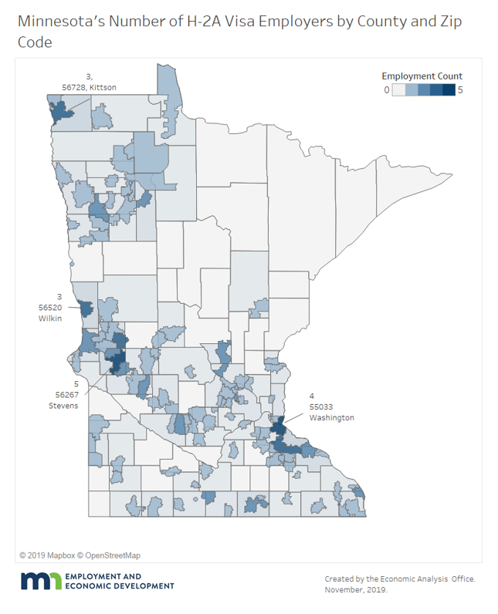
Map of H-2A visa employers in Minnesota
NW Region:
Jessica Bordun
Central and Southern Regions:
Mary Garcia

