Slide 1

Hazardous Occupations and Youth Skills Training Program
November 2022

Slide 2

Welcome!
Introductions:
  Alyssa Klein, DEED-VRS
  Corey Walton, USDOL
  Sara Ellstra, DLI
  Rich Wessels, DLI

Slide 3

Agenda
Federal Laws: Child Labor Requirements in Non-Agricultural Occupations
Minnesota Laws: Youth Labor Standards
Youth Skills Training Program

Slide 4



CHILD LABOR REQUIREMENTS
IN NON-AGRICULTURAL OCCUPATIONS
FAIR LABOR STANDARDS ACT

Slide 5



COVERAGE
Two types of coverage:
  Enterprise coverage: If an enterprise is covered, all employees of the enterprise are entitled to FLSA protections
  Individual coverage: Even if the enterprise is not covered, individual employees may be covered and entitled to FLSA protections

Slide 6
ENTERPRISE COVERAGE
Enterprises with:
  At least two (2) employees engaged in commerce
  At least $500,000 a year in business
Hospitals, businesses providing medical or nursing care for residents, schools, preschools and government agencies with at least two (2) employees are covered on an enterprise basis regardless of their annual dollar volume of business

Slide 7
INDIVIDUAL COVERAGE
Workers who are engaged in:
  Interstate commerce
  Production of goods for commerce
  Closely related process or occupation directly essential (CRADE) to such production, or
  Domestic service
Engaging in “interstate commerce” includes:
  Making telephone calls to other states
  Typing letters to send to other states
  Processing credit card transactions
  Traveling to other states

Slide 8
CHILD LABOR COVERAGE
Minors employed by a covered enterprise or who themselves engage in the production of goods for interstate commerce
Minors employed at establishments where goods are produced for interstate commerce
Approximately 90% of all employees in the United States are covered by the FLSA

Slide 9
HOURS THAT 14- AND 15-YEAR-OLDS MAY WORK
Up to 3 hours on a school day, including Fridays;
Up to 18 hours during a week when school is in session;
Up to 8 hours on a non-school day;
Up to 40 hours during a week when school is not in session
Between 7 AM and 7 PM; OR
Between 7 AM and 9 PM from June 1 through Labor Day; and
Outside school hours
Note: There are some exceptions for 14- and 15-year-old students enrolled in Work Experience and Career Exploration Programs (WECEP) and Work Study Programs (WSP)

Slide 10
RETAIL & SERVICE JOBS 14- AND 15-YEAR-OLDS MAY DO
Errands and deliveries by foot, bike, bus or train
Certain clean-up work and yard work
Pumping gas and hand cleaning cars
Kitchen work, preparing and serving food (but very limited cooking)
Office and clerical work
Cashiering and selling
Price marking, assembling orders, packing
Bagging and carrying out customers’ orders

Slide 11

PROHIBITED WORK FOR 14- AND
15-YEAR-OLDS
Manufacturing and mining
Most processing occupations
Operating power-driven equipment
Transportation of persons or property
Communications
Warehousing and storage
Construction
Work in or about boiler or engine rooms
Maintenance or repair of a building or equipment
Work in freezers and meat coolers
Outside window washing that requires working from window sills
Baking
All occupations declared to be hazardous for 16- and 17-year-olds

Slide 12
WORK AND CAREER EXPORATION AND WORK STUDY PROGRAMS
There are some exceptions for 14- and 15-year-old students enrolled in Work Experience and Career Exploratory Programs (WECEP) and Work Study Programs

Slide 13

HAZARDOUS OCCUPATIONS
The FLSA prohibits minors under age 18 from performing occupations that the Secretary of Labor declares to be particularly hazardous or detrimental to their health and well-being. Currently there are 17 Hazardous Occupations Orders (HOs)

Slide 14
HAZARDOUS OCCUPATIONS ORDERS
1 THROUGH 9
HO 1. Manufacturing or storing explosives
HO 2. Driving a motor vehicle or work as an outside helper on motor vehicles
HO 3. Coal mining
HO 4. Forest fire fighting, forecast fire prevention, timber tract, forestry service, and logging and sawmilling
HO 5. Power-driven woodworking machines
HO 6. Exposure to radioactive substances and ionizing radiation
HO 7. Power-driven hoisting apparatus
HO 8. Power-driven metal-forming, punching and shearing machines
HO 9. Mining, other than coal

Slide 15
HAZARDOUS OCCUPATIONS ORDERS
10 THROUGH 17
HO 10. Power-driven meat-processing machines, slaughtering, rendering and meat packing plants
HO 11. Power-driven bakery machines
HO 12. Power-driven paper-products machines, scrap paper balers, and paper box compactors
HO 13. Manufacturing of brick, tile and related products
HO 14. Power-driven circular saws, band saws and guillotine shears, chain saws, reciprocating saws, wood chippers, and abrasive cutting discs.
HO 15. Wrecking, demolition, and shipbreaking operations
HO 16. Roofing occupations and work on or about a roof
HO 17. Trenching and excavation operations
**The term "operation" as used in HO’s 5, 8, 10, 11, 12 and 14 generally includes the tasks of setting up, adjusting, repairing, oiling, and cleaning the equipment

Slide 16
EXCEPTIONS AND EXEMPTIONS
Exceptions and Exemptions
Apprentices and Student Learners enrolled in an approved program can be exempt from HO 5, 8, 10, 12, 16 and 17 under certain conditions
Parental exception:
Children of any age are generally permitted to work for businesses entirely owned by their parents, except:
Those under age 16 may not be employed in mining or manufacturing and
No one under 18 may be employed in any occupation the Secretary of Labor has declared to be hazardous

Slide 17
ADDITIONAL COMPLIANCE ASSISTANCE MATERIALS
Youth Rules
Child Labor Rules Advisor
Child Labor Bulletin 101
Fact Sheet #43
FLSA Poster
FOH SECTION 33C
1-866-4US-WAGE (1-866-487-9243)

Slide 18
CONTACT INFORMATION
Corey Walton
Community Outreach and Resource Planning
U.S. Department of Labor/Wage & Hour Division
walton.corey@dol.gov

Slide 19
DISCLAIMER
This presentation is intended as general information only and does not carry the force of legal opinion.
The Department of Labor is providing this information as a public service. This information and related materials are presented to give the public access to information on Department of Labor programs. You should be aware that, while we try to keep the information timely and accurate, there will often be a delay between official publications of the materials and the modification of these pages. Therefore, we make no express or implied guarantees. The Federal Register and the Code of Federal Regulations remain the official source for regulatory information published by the Department of Labor. We will make every effort to keep this information current and correct errors brought to our attention.

Slide 20

Youth Labor Standards in Minnesota
Sara Ellstra
Supervisor| Labor Standards

Slide 21
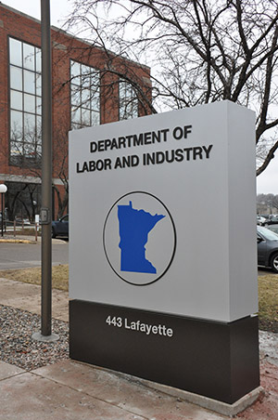
Labor and Industry - Units
Apprenticeship Minnesota
Construction Codes and Licensing (CCLD)
Labor Standards
MN OSHA Compliance
MN OSHA Workplace Safety Consultation
Projects & Planning
Workers’ Compensation

Slide 22


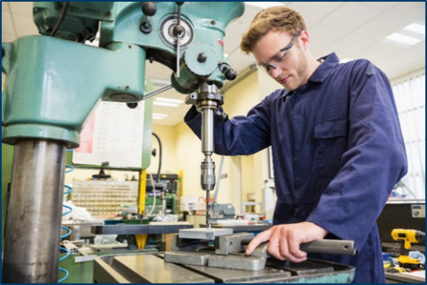
Labor Standards enforced by DLI
Minnesota Fair Labor Standards Act
Women’s Economic Security Act
Child Labor Standards Act
Minnesota Prevailing Wage Act
Wage Theft Prevention Act
Other laws related to employment,
wages, conditions, hours.
Notes:
Discuss big picture – how this helps worker, how this helps business

Slide 23
State law – Minimum wage
Employer/employee type | Minimum wage rate
Large employer – Any enterprise with annual gross revenues of $500,000 or more | $10.33/hour (2022), $10.59 (2023)
Small employer – Any enterprise with annual gross revenues of less than $500,000 Training wage – May be paid to employees aged 18 and 19 in the first 90 days of employment Youth wage – May be paid to employees aged 17 or younger | $8.42/hour (2022), $8.63 (2023)
J-1 Visa – May be paid to employees of hotels, motels, lodging establishments and resorts working under the authority of a summer work, travel exchange (J) visa | $8.42/hour (2022), $8.63 (2023)
*minimum wage adjusts January 1 of each year.
Notes:
Law changed in 2014, was $6.15 then.
Federal minimum wage is $7.25 since 2009.
Minneapolis min wage started January 1, 2018. Goes to $10.25 for small employers (less than 100 employees) and $11.25 (more than 100 employees) on July 1, 2018. Then will continue to go up on July 1 of each year until 2024 when small and large businesses get to $15.
A 2017 survey conducted by the University of Minnesota found that 33% of Minnesotans had personally or knew someone who had been paid less than the minimum wage in effect at the time in a job they held.
Prevailing wages for State and State Highway construction work have different minimum wages, as determined by DLI.

Slide 24

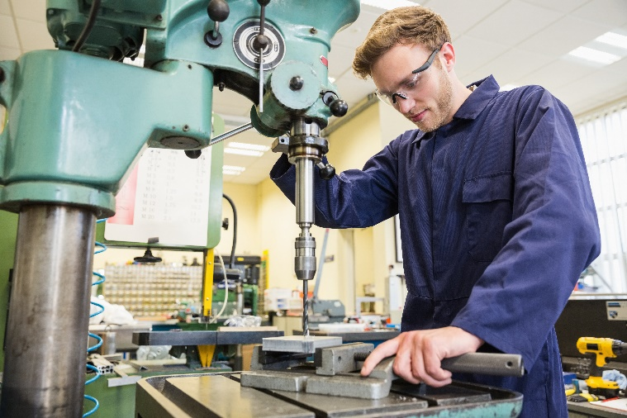
Employee notice
Employers are required to keep a copy of the notice signed by each employee.
Employers are also required to provide employees in writing any changes to the information in the notice before the date the changes take effect.

Slide 25
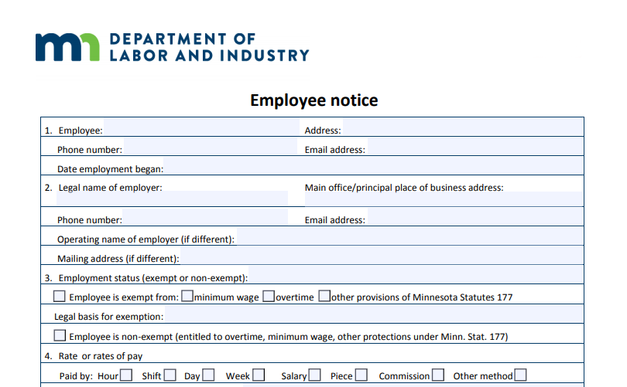
Employee notice continued 2

Slide 26
Minnesota Child Labor Standards Act
The purpose of sections 181A.01 to 181A.12 is to aid in the economic, social and educational development of young people through employment. Work is an integral factor in providing a sense of purpose, direction, and self-esteem necessary to the overall physical and mental health of an individual. Young people, especially those who have completed high school or occupational training, should not be denied employment opportunities. Work, however, must be coordinated with schooling and safety considerations in order to serve the best interest of the young.

Slide 27
The “Three Paths” of Minnesota Youth Labor Standards
Question | Minor <14 Years of Age | Minor <16 Years of Age | Minor <18 Years of Age
Can the Minor Work? | Generally not able to work except by exemption or by permit. | Generally able to work at 14 years of age. | Generally able to work at 14 years of age.
Are There Occupations That the Minor May Not Engage In? | Subject to all hazardous occupations restrictions—unless an exemption is met. | Subject to all hazardous occupations restrictions—unless an exemption is met. | Subject to hazardous occupations restrictions for minors under the age of 18 unless exemption is met.
What Hours Can the Minor Work? | Between 7:00 a.m. – 9:00 p.m. only, maximum of 8 hours in 24-hour period and 40 hours in a week. Employment during school hours requires employment certificate. | Between 7:00 a.m. – 9:00 p.m. only, maximum of 8 hours in 24-hour period and 40 hours in a week. Employment during school hours requires employment certificate. | High school students cannot work after 11:00 p.m. on evening before school day or before 5:00 a.m. on school day, except can work until 11:30 p.m. and at 4:30 a.m. with written parental permission.
Can the Minor Work During School Hours? | If working during school hours, must obtain employment certificate—unless an exemption is met. | If working during school hours, must obtain employment certificate – unless an exemption is met. | No limitation on working during school hours.
Notes:
177.23, Subsection 7: Employee Definition
There are 19 exceptions to the definition of Employee. (example: Taxi drivers, ski facility workers)
There are executive, administrative and professional tests in Rules 5200.0190, 5200.0200 and 5200.0210

Slide 28
Special Concern: The Presence of Liquor
Generally, minors under the age of 18 cannot work in rooms or areas where liquor is consumed or served, or in tasks prohibited by law that involve the sale, service, dispensation, or handling of liquor.
Minors who have reached the age of 16 can be employed:
  As a Busser, Dishwasher, and Host in rooms/areas of a restaurant, hotel, motel, or resort where the presence of intoxicating liquor or 3.2 malt liquor is incidental to food service or preparation;
  As a Busser, Dishwasher, Host, or Server in rooms/areas where the presence of 3.2 percent malt liquor is incidental to food service or preparation;
  To provide musical entertainment in those rooms/areas where the presence of intoxicating liquor and 3.2 percent malt liquor is incidental to food service or preparation; and
  In occupations not prohibited by law in rooms or areas where no liquor is consumed or served.

Slide 29
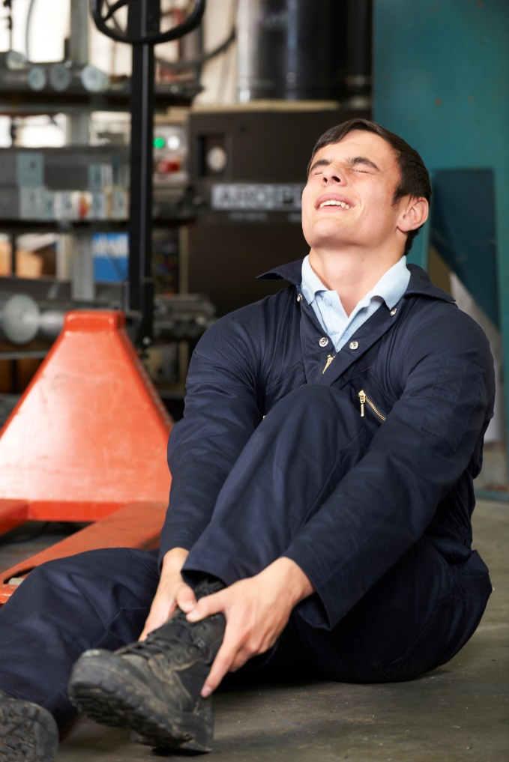
Hazardous Employment Activities
Examples (subject to limitation in the rule or exemption)
  Under 18 (Minn. R. 5200.0910):
    In or about construction or building projects, logging or lumbering operations, paper mills, sawmills; to operate or assist in the operation of power-driven machinery; to drive certain motor vehicles; or to work in rooms or areas where certain alcohol is served or consumed, or in any tasks involving the serving, dispensing, or handling of alcohol that are consumed on premises.
  Under 16 (Minn. R. 5200.0920):
    To lift, carry, or personally care for patients in hospitals or nursing homes; to operate or assist in the operation of machinery including farm type tractors and other self-propelled vehicles, snow blowers and other power-driven lawn and garden equipment; in walk-in meat freezers or meat coolers; or in any occupation in agriculture that the U.S. secretary of labor finds to be hazardous for minors under the age of 16.

Slide 30

Hazardous Employment Activities – Statue and Rule-based Exemptions
Minors working for a family farm corporation where the minor’s parent is a member of the family farm corporation
Minors working for corporations owned by one or both parents, where the daily corporate business is supervised by the parent(s)
Performer/newspaper carriers/youth athletic referees/home chores/babysitting: 181A.07
Tasks outside the area of hazard
High school graduates who are 17 years of age

Slide 31
Approved Training Program Exemptions
The Commissioner of DLI may grant exemptions from some child labor restrictions to training programs, including those approved by MDE, DEED, and some other agencies.
A training program child labor exemption is required if the employment contemplated in the training program involves a hazardous occupation.
  Note: If the exception sought relates to minors working during school hours on school days, the district may be able to issue an employment certificate.
  Districts/employers requesting training program child labor exemptions for hazardous occupations will need to have an MDE (or other agency) approved training program before seeking an exception from DLI.
  When seeking a training program exception from DLI, the program will need to:
Submit proof of workers’ compensation insurance and information about specific machines, tools and equipment that may be used by the program;
Provide a summary of industry-related classes a student will take prior to the paid work experience
Have student learner agreements in place between the school, the employer, the minor student, and their parent; and
Meet with OSHA Workplace Safety Consultation about equipment and related safety measures.

Slide 32

DLI Child Labor Exemption Permits
DLI receives applications for child labor exemption permits
  Must be filed by the minor’s parent, guardian, school official, or youth employment specialist.
  Assessed on a case-by-case basis, granted if the permit would be in the best interest of the minor.
  Permits can be sought and may be granted for any of the child labor laws and rules.
  Turnaround time varies by season.
  Permits are available as fillable PDFs at https://www.dli.mn.gov/business/employment-practices/child-labor-exemptions

Slide 33
Child labor resources
Child and youth labor landing page:
Age restrictions, exemption permits, FAQs, hours of work, penalties, prohibited work, proof of age, teen worker fact sheet
https://www.dli.mn.gov/business/employment-practices/child-labor-laws
Informational videos in four languages:
http://dli.mn.gov/labor-standards-videos

Slide 34
Thank You!
Sign up for our Wage and Hour Bulletin: www.dli.mn.gov/business/employment-practices/minnesota-wage-and-hour-bulletin
Contact DLI’s Labor Standards at 651-284-5075 or dli.laborstandards@state.mn.us.

Slide 35


Youth Skills Training
2.0

Slide 36
YST Program
What is the Youth Skills Training (YST) program?
  Supporting partnerships between industry and education
  Creating opportunities for students to learn about industries
  Providing industry-related classes and safety training
  Establishing safe, healthy and meaningful paid work experiences
  Developing a pathway for future talent

Slide 37
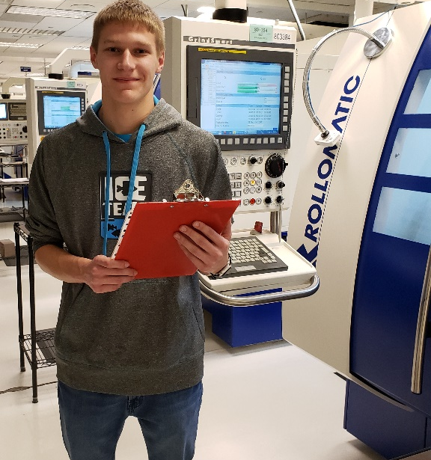

YST Program continued 2
Current YST eligible industries:
Advanced Manufacturing
Agriculture
Automotive
Health Care
Information Technology

Slide 38
YST Program Goals
GOALS:
Support the creation of local partnerships
High Schools
Employers
Chambers of Commerce
Workforce Groups
Nonprofit organization
Postsecondary institutions
Local Partnerships
High Schools
Employers
Community
Organizations

Slide 39
YST Program Goals continued 2
GOALS:
2. introduce students to careers in high-growth, high-demand industries
3. prepare students for successful careers
4. address the shortage of skilled employees
Exposure
Education
Experience

Slide 40
Paid Work Experiences
Learn & Earn model
Develop paid work experiences for 16 and 17-year-old “student learners” to participate in safe, healthy and meaningful on-the-job training at employer sites
Classroom
instruction
to learn skills
Paid work experience to develop skills
Youth Skills Training program
YST@DLI

Slide 41
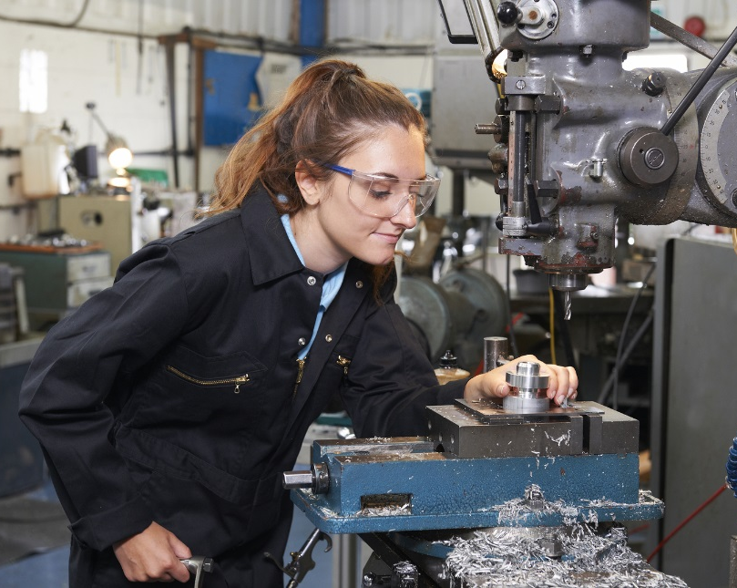
School Requirements
School requirements:
  Industry exposure opportunities for students of all ages
  Industry-related classes for high school credit
  Industry-recognized credential/certification
  Paid work experience for students 16 years of age and older

Slide 42

Employer Requirements
Employer requirements:
  Partner with local schools
  Seek employer approval through YST program
  Create a safe, healthy, meaningful paid work experiences
  Train and mentor student learners
  By meeting YST requirements and receiving approval from DLI, student learners are
  allowed to work in industries otherwise prohibited by child-labor laws.

Slide 43
Employer Approval Process
YST Programs can be approved with or without YST grant funding
Step 1: Employer submits | - Proof of Workers’ Compensation - Equipment & tool review (Form 1)
Step 2: School submits | - Class syllabus from industry related class(es) for high school credit

Slide 44
Employer Approval Process continued 2
Step 3: Safety Meeting | - Review all information submitted with YST staff and a safety consultant
Step 4: YST staff/employer | - YST statute, final review and signature
Step 5: All parties | - Parent, student, school, employer complete and sign training agreement
Safe, healthy and meaningful paid work experiences

Slide 45
Employer Approval Process continued 3
A YST safety meeting is not:
The YST safety meeting is not an OSHA inspection
The YST safety meeting does not result in citations or fines
The YST safety meeting will not trigger an OSHA inspection
The YST safety meeting is not entered into a data base or recorded for any purpose other than YST program approval

Slide 46
YST Grants
YST program grant funding:
  Total of $1,000,000 in grant funding awarded each year
  Grants up to $100,000 awarded to local partnerships
  Two-year grant period
  49 YST grants have been awarded throughout the state since the start of the program in 2017

Slide 47
YST Grants continued 2
YST grant round 6 timeline:
  Oct. 17 to Nov. 4, 2022: Letter of Intent accepted
    The letter of intent is an online form (link posted on dli.mn.gov/yst)
  Nov. 7 to Dec. 2, 2022: Grant applications accepted
  Feb. 14, 2023: Grantees announced
  July 1, 2023, to June 30, 2025: Grant performance period

Slide 48
YST Grants continued 3
YST grant funding uses:
Marketing and advertising programs
Recruiting schools, employers and students
Employer training
Student transportation
Staff to coordinate and monitor program outcomes
Student credentials/certifications
**Funds cannot be used to pay student wages**

Slide 49
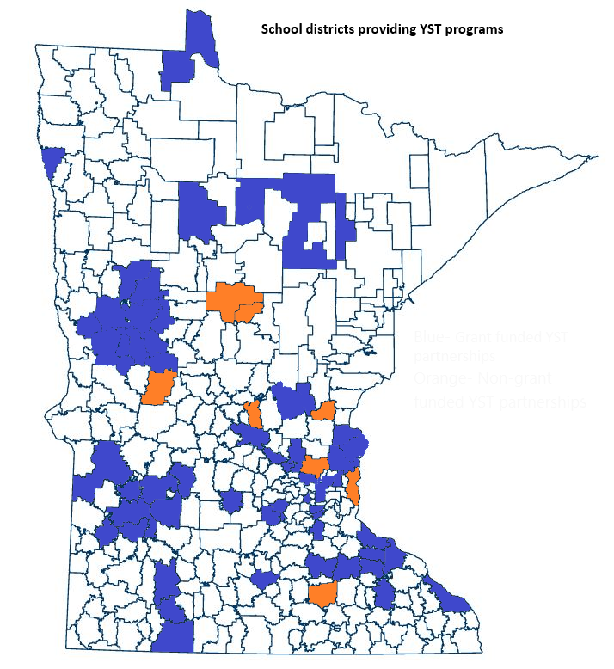
YST Program Grantees
YST grant recipients
Red Wing Ignite
Hutchinson
TwinWest
White Bear Lake
Winona
Elk River
Forest Lake
Vadnais Heights Economic Development (VHEDC)
SW MN Private Industry Council
Intermediate District #287
Bloomington
Ramsey County Workforce
Genesys Works
Spark-Y
Bemidji
Faribault
Burnsville
Detroit Lakes
Goodwill Industries
Lakeville
Monticello
North Branch
Princeton
SW Metro District #288
Hibbing
Boys & Girls Club of Central MN
Southeast Service Cooperative
American Nursing & Technical
Marvin
ISD # 112 Eastern Carver County
Roseville Area Schools
Mankato Area Public Schools
Chisago Lakes School District
Grand Rapids Area Chamber of Commerce
Milaca Public Schools
East Grand Forks Public Schools
Otter Tail County
Blue = Grant Funded YST school districts
Orange = YST school districts that created programs without grant funding

Slide 50
YST Program continued 3
Since start of program in 2017:
  41,005 students provided with industry exposure
23,498 students have completed industry related classes
  1,410 students have earned an industry related credential
537 students have participated in a paid work experience

Slide 51
Contact Information
Rich Wessels Alana McDevitt
Project Manager Program Specialist
651-284-5184 651-284-5341
Rich.Wessels@state.mn.us Alana McDevitt@state.mn.us
www.dli.mn.gov/yst

Slide 52

Questions?
Notes:
Beth

