Slide 1
NortherN States POWER MINNESOTA VALLEY PLANT Decommissioning Project
Project Overview
John Hunt and Jim Bodensteiner
August 30, 2022

Slide 2
Agenda
NSP Fleet Transformation
Project Planning
Project Execution
Lessons Learned

Slide 3
NSP FLEET TRANSFORMATION
Objectives:
retire entire coal fleet in the Upper Midwest by 2030;
extend the life of our Monticello nuclear plant to 2040;
expanding our renewable resources, adding 2,150 megawatts of wind and 2,500 megawatts of large-scale solar in the next 10 years;
reduce carbon emissions in the Upper Midwest more than 85% by 2030;
remain on pace to provide carbon-free electricity for our customers by 2050.

Slide 4
PROJECT PLANNING
Decommissioning Scoping
Plant Shutdown
Project Execution
Decommissioning Documentation
Post-Closure Site Management

Slide 5
DECOMMISSIONING SCOPING
Analyze pros and cons and provide a decision on the desired end state for the site;
Identify/inventory onsite equipment and materials;
Identify recognized environmental conditions or other environmental concerns;
Determine the presence of building physical hazards to assist with scope, cost, and schedule;
Identify permits needed to support plan implementation;
Identify site restoration and remediation objectives.

Slide 6
PLANT SHUTDOWN
De-energize equipment
Removal of Consumables (chemicals, fuels, etc.)
Disconnection of Unnecessary Utilities
Reconciliation of Plant Permits
Site Security

Slide 7
PROJECT EXECUTION
Develop / Issue Engineering Services RFP
Prepare Permit Applications
Develop / Issue Demolition Services RFP
Demolition / Site Restoration
Demolition Documentation

Slide 8
MINNESOTA VALLEY PLANT
Plant operated from early 1930’s - 2004
Ash Landfill closed in-place in 1988
Ash Ponds closed by removal in 2010-2011
Hydroelectric dam removed in 2012-2013
Coal Yard closed in 2018-2019
Powerhouse Demolition – Sept 2021 through Dec 2022

Slide 13
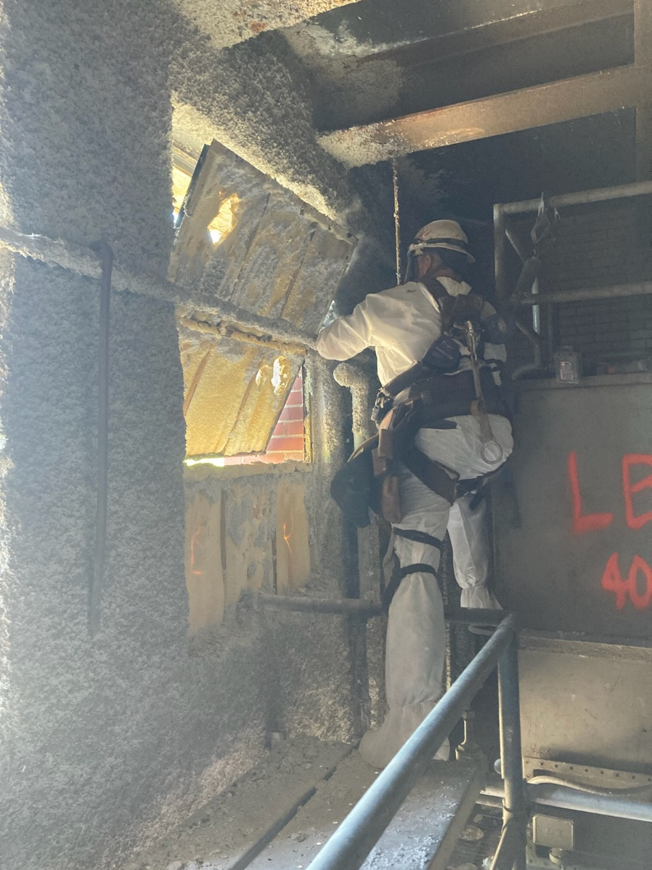
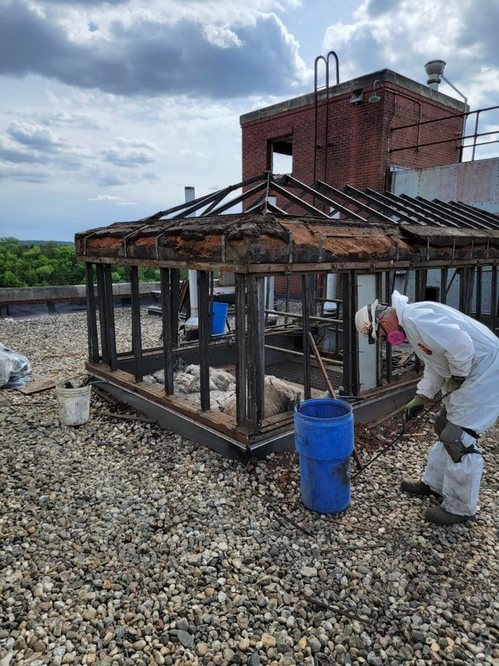

Slide 14
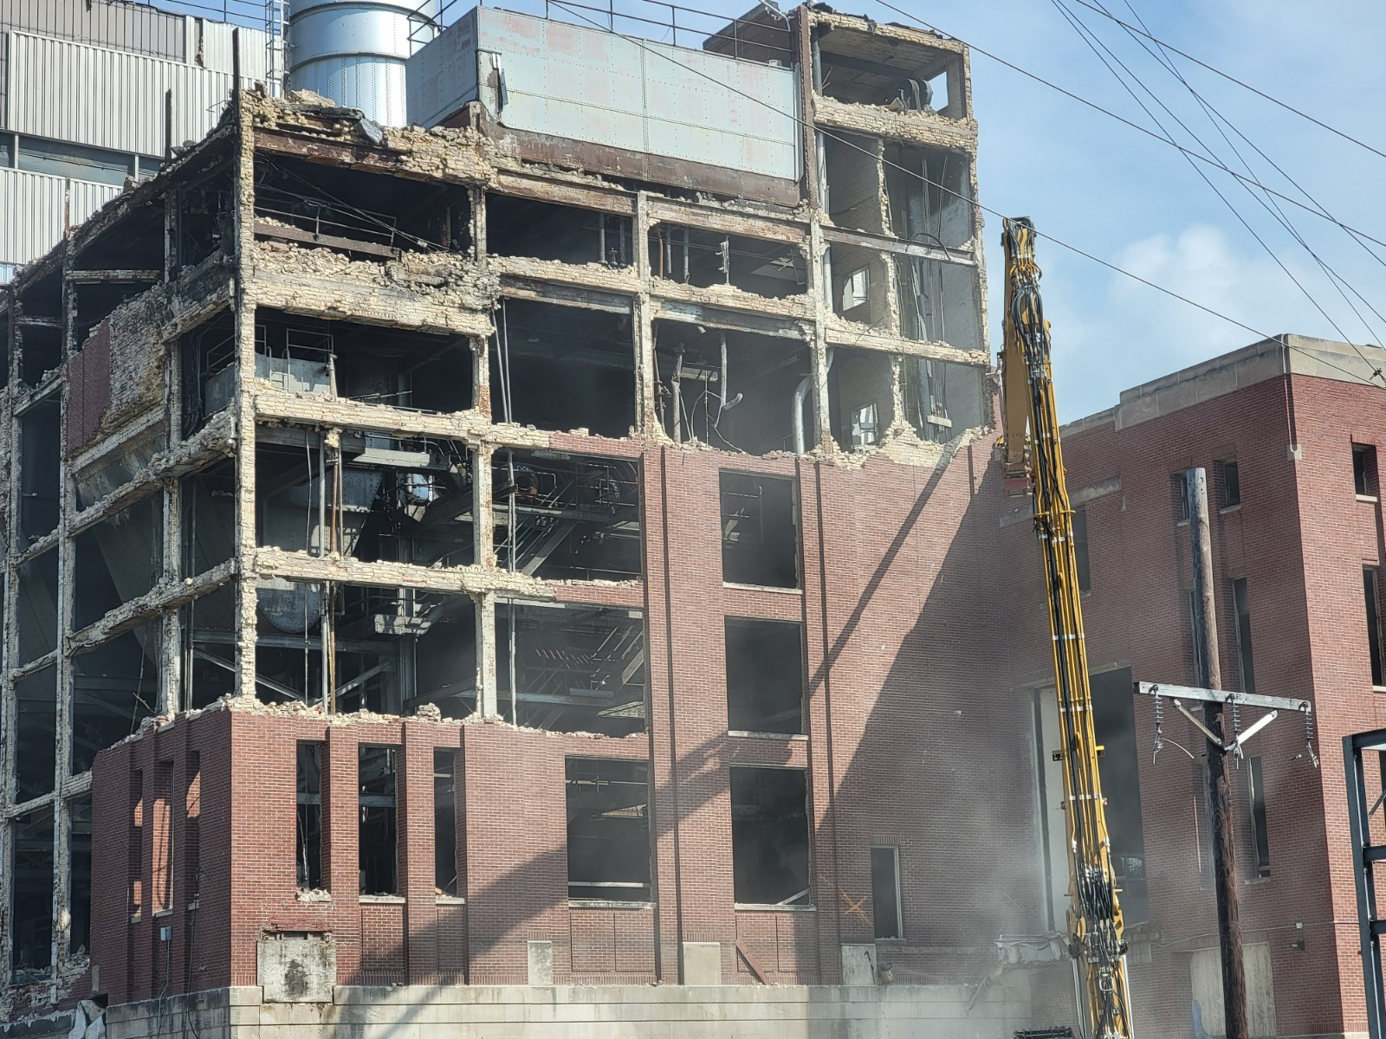

Slide 15
DECOMMISSIONING DOCUMENTATION
Contractual Requirements
Corporate Requirements
Permit-related Requirements

Slide 16
POST-CLOSURE SITE MANAGEMENT
Security / Site Access
Grounds Maintenance
Long-term Ownership?

