Slide 1
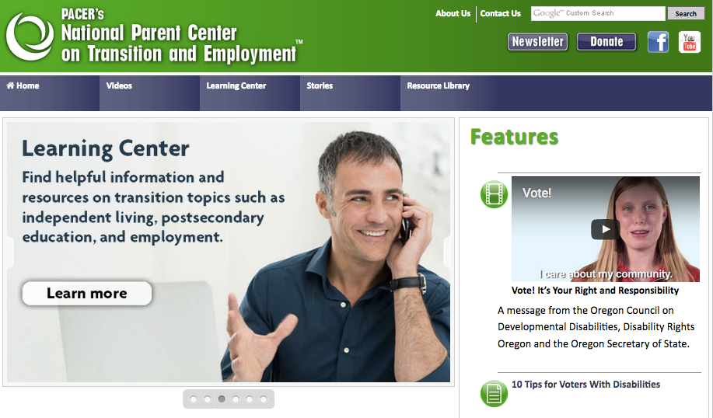
pacer.org/transition

Slide 2
www.facebook.com/npcte
www.pacer.org

Slide 3
The Guideposts for Success
http://www.ncwd-youth.info/guideposts
What ALL Youth Need
to Successfully
Transition to Adulthood

Slide 4
Core Principle
A person with a disability is a person first, and a person with a disability second.
They will likely need all the same things to succeed as a person without a disability, but may also require additional supports.

Slide 5
Guideposts basic values
High expectations for all youth
Equality opportunity and inclusion;
Self-determination, informed choice, and participation in decision-making
Independent living with or without supports
Competitive employment and economic self-sufficiency, with or without supports
Individualized transition planning that is person-driven and culturally and linguistically appropriate.

Slide 6
Meeting the Needs of Youth: The Guideposts for Success
School-Based Preparatory Experiences
Career Preparation & Work-Based Learning Experiences
Youth Development & Leadership
Connecting Activities
Family Involvement & Supports
Notes:
Guideposts for Success based on what research shows that all youth need to transition to adulthood successfully.
School-Based Preparatory Experiences that contribute to student success for youth with and without disabilities.
Career Preparation and Work-Based Learning Experiences that youth with and without disabilities need to identify and to reach their career goals.
Youth Development and Leadership Experiences that help youth with and without disabilities exercise leadership, build self-esteem, and gain knowledge and skills to help them control and direct their own lives.
Connecting Activities such as programs, services, activities, and supports that can help youth, depending on their individual needs, successfully pursue their post-school goals.
Family Involvement and Supports provided by parents, family members, and other caring adults that promote the social, emotional, physical, academic, and occupational growth of youth with and without disabilities.

Slide 7
Implications for Your Work
Research-based and rooted in promising practices
Helpful approach to youth assessment and service coordination – integrated resource teams
Great launching point for resource mapping
Helps programs to think broader
Helpful in program planning

Slide 8
14 WIOA Youth Program Elements

Slide 9
Notes:
The purpose of this publication is to provide guidance to Minnesota CareerForce youth development professionals on how to intentionally integrate the Guideposts for Success framework into the Individualized Learning Plan (ILP) model. Developed by PACER Center for Minnesota’s Partners for Youth Disability Employment Initiative (DEI), this guide demonstrates how to merge the core strategies of DEI youth-focused projects — career pathways, Integrated Resource Teams (IRTs), and the Guideposts — with ILP career planning activities for both in-school and out-of-school youth.

Slide 10
Individualized Learning Plans – A National Movement
Component of state-driven efforts to improve youth employment outcomes
Both a document and a planning process
Provides middle and high school students with quality career development opportunities in the areas of
Self exploration
Career exploration
Career planning and management

Slide 11
Benefits for youth
Youth engaged in self-exploration, career exploration and career planning and management ILP activities are
More engaged, motivated and confident learners
May select more rigorous courses
Consider new and different career options
Decide to stay in school rather than dropping out
Increase academic aspirations toward college goals
Better communication with families

Slide 12
Minnesota’s Personal Learning Plans (PLPs)
Minnesota Statutes, section 120B.125 requires all students beginning no later than 9th grade to have a Personal Learning Plan.
Purpose: to help all students explore their career interests and develop a plan for a smooth transition to postsecondary education and employment
English language learners must be provided with adequate instruction and sufficient resources to enable them to participate in the PLP process
Each student’s PLP must reflect his or her unique talents, skills, and abilities
Each PLP must be reviewed annually by student, parent and school to ensure adequate progress
Notes:
Minnesota Statutes, section 120B.125 requires all students beginning no later than 9th grade to have a Personal Learning Plan around several key elements. This plan should be looked at as a life plan that includes academic scheduling, career exploration, career and employment-related skills, community partnerships, college access, all forms of postsecondary training, and experiential learning opportunities.

Slide 13
PLPs and Students with Disabilities
“If a student with a disability has an IEP or standardized written plan that meets the plan components of this section, the IEP satisfies the requirement and no additional transition plan is needed.”

Slide 14
Aligning IEP Transition Plans with the nine PLP requirements
Provide a comprehensive plan to prepare for and complete a career and college-ready curriculum by meeting state and local academic standards and developing career and employment-related skills such as team work, collaboration, creativity, communication, critical thinking and good work habits;
Emphasize academic rigor and high expectations and inform the student, and the student’s parent or guardian if the student is a minor, of the student’s achievement level score on the Minnesota Comprehensive Assessments that are administered during high school;
Help students identify interests, aptitudes, aspirations, and personal learning styles that may affect their career and college-ready goals and postsecondary education and employment choices;
Set appropriate career and college-ready goals with timelines that identify effective means for achieving those goals;
Help students access education and career options;
Integrate strong academic content into career-focused courses and applied and experiential learning opportunities and integrate relevant career-focused courses and applied and experiential learning opportunities into strong academic content;
Help identify and access appropriate counseling and other supports and assistance that enable students to complete required coursework, prepare for postsecondary education and careers, and obtain information about postsecondary education costs and eligibility for financial aid and scholarships;
Help identify collaborative partnerships among Pre-K through grade 12 schools, postsecondary institutions, economic development agencies, and local and regional employers that support students’ transition to postsecondary education and employment, and provide students with applied and experiential learning opportunities;
Be reviewed and revised at least annually by the student, the student’s parent or guardian, and the school or district to ensure that the student’s course-taking schedule keeps the student making adequate progress to meet state and local academic standards and high school graduation requirements, and with a reasonable chance to succeed with employment or postsecondary education without the need to first complete remedial course work;
Notes:
Provide a comprehensive plan to prepare for and complete a career and college-ready curriculum by meeting state and local academic standards and developing career and employment-related skills such as team work, collaboration, creativity, communication, critical thinking and good work habits;
Emphasize academic rigor and high expectations and inform the student, and the student’s parent or guardian if the student is a minor, of the student’s achievement level score on the Minnesota Comprehensive Assessments that are administered during high school;
Help students identify interests, aptitudes, aspirations, and personal learning styles that may affect their career and college-ready goals and postsecondary education and employment choices;
Set appropriate career and college-ready goals with timelines that identify effective means for achieving those goals;
Help students access education and career options;
Integrate strong academic content into career-focused courses and applied and experiential learning opportunities and integrate relevant career-focused courses and applied and experiential learning opportunities into strong academic content;
Help identify and access appropriate counseling and other supports and assistance that enable students to complete required coursework, prepare for postsecondary education and careers, and obtain information about postsecondary education costs and eligibility for financial aid and scholarships;
Help identify collaborative partnerships among Pre-K through grade 12 schools, postsecondary institutions, economic development agencies, and local and regional employers that support students’ transition to postsecondary education and employment, and provide students with applied and experiential learning opportunities;
Be reviewed and revised at least annually by the student, the student’s parent or guardian, and the school or district to ensure that the student’s course-taking schedule keeps the student making adequate progress to meet state and local academic standards and high school graduation requirements, and with a reasonable chance to succeed with employment or postsecondary education without the need to first complete remedial course work;

Slide 15
Minnesota Career Information System (MCIS)
Districts are free to determine their own means for implementing, selecting resources, reviewing and record keeping of the students' plans, however, MCIS works with over 80% of MN schools.
MCIS provides educators and students with a rich collection of self-exploration, career exploration and career planning tools.
In addition to constructing a PLP, students are able to create a personal ePortfolio that they can continue to access and add to after they leave high school.
In-school youth have direct access to their MCIS portfolio
Pre-ETS
Out-of-School Youth
ABE
Notes:
Districts are free to determine their own means for implementing, selecting resources, reviewing and record keeping of the students' plans, however, MCIS works with over 80% of MN schools.
MCIS provides educators and students with a rich collection of self-exploration, career exploration and career planning tools which can be used to create a student’s PLP.
In addition to constructing a PLP during their middle and high school years, students are able to create a personal ePortfolio that they can continue to access and add to after they leave high school.
In-school youth have direct access to their MCIS portfolio
Pre-ETS
Out-of-School Youth
ABE

Slide 16
Guidepost 1: School-Based Preparatory Experiences
Communication skills (Reading, writing, speaking)
Coding, Keyboarding skills
Soft-skill development
Tutoring, study skills training
Basic skills training including remedial reading and math
Learning Style inventories
Interest inventories
Practice job interviews
Identify a program of study related to career interests
CTE Programs
Service Learning
Pre-ETS
IEP/504 Transition planning
Practice disability disclosure

Slide 17
Guidepost 2: Career Preparation and Work- Based Learning Experiences
Career exploration activities such as Guest speakers
Job Shadowing
Field trips
Informational interviews
Labor market research
Online Career assessments
Develop a resume
Identify career goals and a course of study
Apply to career-related postsecondary program
Visit postsecondary campuses and offices of disability services
Internships and volunteering
Subsidized work experience
Identify effective job accommodations
Apprenticeship programs

Slide 18
Guidepost 3: Youth Development and Leadership Experiences
Extracurricular activities
Hobbies and recreational activities
Learning style inventories and interest assessments
Mentoring programs
Discuss career interests with family role models
Training in decision-making skills
Prepare youth to lead IEP and IRT meetings
Build disability self-awareness
Practice disability disclosure and requesting accommodations
Plan for transition to adult heath care
Volunteering and service learning programs
“Discovery” assessment activities
Practice appropriate hygiene and self-care

Slide 19
Guidepost 4: Connecting Activities
Driver’s License
Transportation mobility training
Housing
Apply for financial aid
Community ed or recreation programs
Plan for transition to adult health care
Help youth access health insurance coverage
Financial literacy programming
Substance abuse counseling
Mental health counseling
Apply for Social Security
Apply for Ticket to Work
Meet with benefits planner
Connect with Vocational Rehabilitation
Connect with Center for Independent Living

Slide 20
Guidepost 5: Family Involvement and Supports
Be sensitive to cultural values of family
Engage parents in assessment process
Communicate with families to review youth’s progress
Invite families to Integrated Resource Team meetings and inform them how they can follow up at home
Share how to use personal and professional networks for career exploration purposes with families
Connect families to information
Connect families to opportunities that can help address education, mental health, transportation, housing, and advocacy needs of youth or families themselves
Brainstorm about natural supports to help meet transportation, housing or other needs

