Slide 1
Pre-ETS Training for VRS Providers: Part I What are Pre-ETS? Who Can Receive Them?
Recorded November 2020

Slide 2
Agenda
Overview of Pre-Employment Transition Services (Pre-ETS)
Understanding the definition of a “student with a disability” for Pre-ETS purposes
Review Resources

Slide 3
What are Pre-Employment Transition Services (Pre-ETS)?

Slide 4
Required by WIOA
President Barack Obama signed the Workforce Innovation and Opportunity Act (WIOA) into law on July 22, 2014.
Amends the Rehabilitation Act of 1973
Key changes impacting youth with disabilities:
Pre-employment transition services (Pre-ETS)
Limitations on the use of subminimum wage
Final regulations published 08-19-16

Slide 5
More collaboration than ever before…
Schools
Community Providers
VRS
Counties

Slide 6
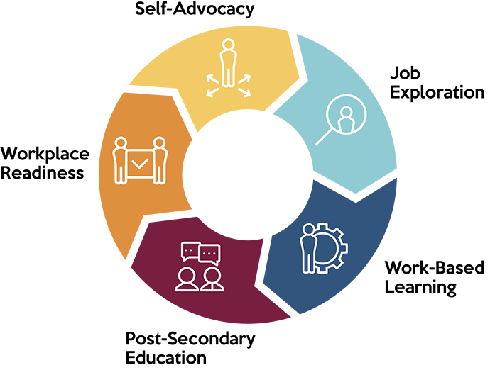
Pre-Employment Transition Services (Pre-ETS) 5 Required Services
Job Exploration Counseling
Work-Based Learning Experiences
Postsecondary Education Counseling
Workplace Readiness Training
Instruction in Self-Advocacy

Slide 7
Funding Requirement
VR programs are required to spend 15% of their federal funds on Pre-ETS annually
Minnesota: $6.8 million
15%

Slide 8
For Eligible and Potentially Eligible Students
Students Eligible for VR:
Have applied for and been determined eligible for traditional VR services
VRS counselors include needed Pre-ETS as part of the Employment Plan
Students Potentially Eligible for VR (NEW):
Students with documented disabilities, in an education program, ages 14 through 21
VRS Pre-ETS Representatives coordinate needed Pre-ETS (no Employment Plan)

Slide 9
Intent of Pre-ETS
Rehabilitation Services Administration (RSA) Regulations:
"Pre-employment transition services represent the earliest set of services available for students with disabilities under the VR program, are short-term in nature, and are designed to help students identify career interests."

Slide 10
Intent of the Journey
Pre-ETS (For “potentially eligible” and eligible students)
Other VR Services (For eligible students)
Competitive Integrated Employment

Slide 11
The Actual Journey for Eligible Students
Other VR Services
Pre-ETS and Other VR Svcs.
Pre-ETS
Competitive Integrated Employment

Slide 12
“Traditional” or “General” VR Services Includes
Counseling and guidance
Assessment services
Work-based learning coaching or job coaching
Postsecondary training
Assistive technology
Job placement and other job-related services
And much more!

Slide 13
Pre-ETS Availability
Are provided in collaboration with secondary schools
Must be made available statewide to all students with disabilities, regardless of whether the student has applied or been determined eligible for VR services
Any student with a disability is considered to be “potentially eligible” for Pre-ETS

Slide 14
Defining “Required”
VRS is only required to have Pre-ETS available statewide to those that need them.
VRS is NOT required to provide them to every student with a disability.
Pre-ETS must be provided solely on the basis of the student’s need for that service.

Slide 15
Required but…
None of the provisions mandate that all five Pre-ETS activities be provided to each student with a disability.
There is no requirement that any one type of Pre-ETS precede another type.
There is no requirement that a person receive a prescribed number of Pre-ETS.

Slide 16
It’s about filling in the gaps
“Nothing in this act and regulations will be construed to reduce the obligation under the Individuals with Disabilities Education Act of a local educational agency or any other agency to provide or pay for any transition services…” (§361.22(c))

Slide 17
Pre-ETS Are About Exploration NOT Assessment
Synonyms used for “exploration” include:
Search
Consideration
Enquiry
Journey
Adventure
Synonyms used for “assessment” include:
Evaluation
Estimation
Appraisal
Analysis
Recommendations

Slide 18
Pre-ETS Exploration Experiences
Understanding interests
Summary of what was liked, disliked and learned
What do I do with what I have learned?
Student self-reflection and gaining insight

Slide 19
Assessment
Understanding interests AND skills and abilities
Determining limitations and needs
Evaluator or VR Staff providing report
Observations, ratings and recommendations

Slide 20
Is it Pre-ETS or Other VR Services?
Pre-ETS
Student Driven
Informal
Student or Employer Report
VR Services: Can Include Assessment
Third Party or VRS Staff Driven
Formal
Evaluator Report

Slide 21
Understanding Definition of “Student with a Disability”

Slide 22
Pre-ETS Target Population: Students with Disabilities
3 parts to the definition of “Student with a Disability”:
Disability
Age
Educational Program

Slide 23
1. Disability
Receives special education services/has an IEP; or
Has a 504 plan; or
Otherwise has a documented disability (medical or mental health note or record, social security award letter)

Slide 24
2. Age

Slide 25
“Youth” & “Student” Age Ranges
14 15 16 17 18 19 20 21 22 23 24 25
Student
Pre-ETS
Youth includes those seeking subminimum wage (511)

Slide 26
3. Educational programs include:
Secondary education programs;
Non-traditional or alternative secondary education, juvenile justice or GED or home school programs; or
Postsecondary education programs

Slide 27
Must Yield a Recognized Credential of Education
A verification of an individual’s qualification or competence issued by a third party with the relevant authority to issue such credentials (U.S. Department of Labor, 2010). The term credential encompasses educational certificates, degrees, certifications, and government-issued licenses.

Slide 28
Summer, Breaks and Gaps
Students that graduate from high school and have enrolled in a postsecondary education program in the fall are still considered a student during the summer before school starts up again.
This includes other breaks between the postsecondary sessions.
If a student has a gap year or semester, they can still receive Pre-ETS as long as they are enrolled in a postsecondary education program and their “seat” or “spot” is saved for them. The length of the gap does not matter.

Slide 29
Let’s Summarize! All Three Must Be Checked
Has a disability.
Is between ages 14 through age 21.
Is enrolled in an educational program.
Is in a program where they are working on a high school diploma or GED
OR
Is in a postsecondary education or training program that leads to a recognized credential of education

Slide 30
Are They a Pre-ETS “Student”?
Jeremy is 17 years old and is a junior at XYZ High School
True is 18 years old, graduated from high school in June, and is enrolled to attend ABC Community College in August
Gilbert is 22 years old and attends ABC community college
Daniela is 19 years old and attends Adult Basic Education GED classes
Aayan is 20 years old and attends Metro CRP for office skills training

Slide 31
Resources

Slide 32
DEED-VRS Pre-ETS Webpages
VRS Student Career Services: DEED-VRS webpages for HS Students
Find the VRS staff assigned to each school
Information for High School Staff
Pre-ETS Resources for P/T Contracted Providers
Recorded Trainings
Webinars
Other Resources: Pre-ETS Toolkit and much more

Slide 33
VRS Contact Information
Kim Babine, Director of Community Partnerships
Kim.Babine@state.mn.us
Anne Paulson, Contracts Specialist
Anne.Paulson@state.mn.us
Sara Sundeen, Contracts Specialist
Sara.Sundeen@state.mn.us
Alyssa Klein, VRS Transition and Pre-ETS Specialist
Alyssa.Klein@state.mn.us

Slide 34
Thank you!

Slide 35
Pre-ETS Funding
The pre-employment transition services provided under the VR program are funded by a grant from the U.S. Department of Education with a state match. For federal fiscal year 2020, the total amount of federal grant funds used for these services is $6,374,138 (78.7 percent). The state appropriation indirectly supports the pre-employment transition spending and amounts to $1,725,148 (21.3 percent).

