Slide 1
WORKFORCE ONE (WF1)
Performance Walk-through
WIOA Adult, WIOA Dislocated Worker, and State Dislocated Worker
amy.carlson@state.mn.us
State Program Administrator Coordinator

Slide 2
What's in this Workforce One Guide?
Entering the Participant’s Social Security Number (SSN): Slides 2 – 4
Risks of Using a Pseudo-SSN and Procedure to Create One: Slides 5 – 8
Workforce One Activities that Impact Performance: Slides 9 – 14
Workforce One Exits that Impact Performance: Slides 15 – 19
Workforce One Post-Exit that Impact Performance: Slides 20 – 23
Performance Counts: Slides 24 – 41
Performance Contact Information: Slide 42

Slide 3
Required Documentation for Participant SSNs
At least one of the following must be stored in the participant’s case file as proof of SSN if the SSN entered in WF1 is not in the pseudo-SSN format
SS card issued by Social Security Administration W2 form
IRS form letter 1722
Social Security benefit checks (if it has their name and the SSN on it)
DD-214 Report of Transfer or Discharge
Passport (if it has their name and the SSN on it)
Military ID (if it has their name and the SSN on it)
Other Federal or state ID with a Social Security number containing the person’s name
Please note, self-attestation is insufficient to meet this requirement

Slide 4
Importance of Capturing Actual SSNs in WF1
Social Security Numbers are used to gather information on the participant’s achievements.
We report participant pre-enrollment earnings.
  We report participant earnings after receiving program services
    1st Quarter after program exit earnings
    2nd Quarter after program exit earnings
    3rd Quarter after program exit earnings
    4th Quarter after program exit earnings
  We report education success rates on program funded trainings your participant attends and the success rates of all their classmates attending the same training program

Slide 5
RISKS OF USING A
PSEUDO-SSN & REQUIRED
PROCEDURE TO CREATE ONE

Slide 6
Risks of Using a Pseudo SSN
Post-program earnings will not be determined, which will result in an automatic negative exit.
The search function in Workforce One encompasses many parameters: SSN, name, email address, MAXIS number and Workforce One Record ID or Birthdate. If a pseudo SSN is used, a later search for the person by SSN may not yield a result.

Slide 7
Procedure for Creating a Pseudo SSN
If an individual refuses to supply an SSN and/or adequate documentation, then enter a 9-digit number based on this method:
Start the number with ”000” or “900”
Middle two numbers are the WSA /ISP number = AEOA – 21
Last 4 numbers are assigned in a sequential manner (i.e., 0001, 0002, 0003, etc.)

Slide 8
Workforce Development Area and
Independent Grantee numbers

Slide 9
WORKFORCE ONE ACTIVITIES
THAT IMPACT
PERFORMANCE

Slide 10
What Training Activities need a
Measurable Skills Gain Captured?
Apprenticeship | Classroom Training
Credential Attained without Training | Customized Training
Entrepreneurial Training | GED Training
OJT | Occupational Skills Training
Prerequisite Training | OJT - Public or Private
TAA Apprenticeship | Remedial Training

Slide 11
What Training Activities need a
Credential Captured?
Apprenticeship | Classroom Training
Credential Attained without Training | Entrepreneurial Training
GED Training | Occupational Skills Training
Prerequisite Training | Remedial Training
TAA Apprentice

Slide 12
Important Information
If a participant was scheduled to begin training but before any training costs were applied the participant decided not to attended training
DO NOT SIMPLY CLOSE THE TRAINING ACTIVITY, DELETE IT!
  If there is a training activity on record, reports will look for a captured credential
  If there is not a credential captured, it will result in a a negative in the Credential Attainment Rate

Slide 13
Measurable Skill Gains Data Entry Timeliness
MSGs must be entered into WF1 no later than
15 business days after receiving proof of a gain or within 365 days after the start of the fiscal year
Whichever is earlier

Slide 14
Credentials Attained Data Entry Timeliness
Credentials must be entered into WF1 no later than
10 business days after receiving a copy of the credential or within 365 days from the participant’s exit date
Whichever is earlier

Slide 15
WORKFORCE ONE EXITS
THAT IMPACT
PERFORMANCE

Slide 16
Program Exit Data Entry Timeliness
All participants must be exited from the program after 90 days has lapsed since last date of service
All participant exits must be entered into WF1 no later than 100 days after the last date of service
The exit date in WF1 is
retroactive back to the last date of service

Slide 17
If the participant exits with any of these exit reasons that participant will not be counted in performance outcomes
What does Exited with Exclusion Mean?
DOL Definition of Authorized Exclusion Based on TEGL 10-16 Attachment 2 |  | WF1 Exit Reason
Exits while receiving services due to incarceration in correctional facility or becomes resident of institution providing 24 hour support such as hospital or treatment center |  | Institutionalized
Exits after being called up to active duty for at least 90 days as member of National Guard or other reserve military unit. |  | Reservist Called to Active Duty
Participant is deceased |  | Death
Exits due to medical treatment expected to last longer than 90 days which would preclude employment or continued participation. |  | Medical Treatment

Slide 18
What WF1 Exit Reasons will be counted in
Performance Measures
DEED will check wage detail/Supplemental Wage Information and other performance indicator data for participants exiting with these final Exit Reasons |  | Programs Using
Called Back |  | Dislocated Worker
Cannot Locate |  | Dislocated Worker and Adult
Entered Armed Forces |  | Dislocated Worker and Adult
Entered Registered Apprentice Training |  | Dislocated Worker and Adult
Entered Unsubsidized Employment |  | Dislocated Worker and Adult
Family Care Problems |  | Dislocated Worker and Adult
Found Ineligible |  | Dislocated Worker and Adult
Moved from Area |  | Dislocated Worker and Adult
Program/Type Transfer |  | Dislocated Worker and Adult
Refused to Continue |  | Dislocated Worker and Adult
Remained Employed |  | Dislocated Worker and Adult
Retirement |  | Dislocated Worker and Adult
Started Business/Self-Employed |  | Dislocated Worker and Adult

Slide 19
What are examples of Follow-up Services?
(Available to all participants exited to employment for 12 months after exiting)
Counseling regarding the workplace
Peer support groups
Referral to support services in the community
Provision of performance and program cost information for providers of training
Provision of information on opportunities for job advancement

Slide 20
WORKFORCE ONE POST-EXIT
DATA THAT IMPACT
PERFORMANCE

Slide 21
REQUIRED POST EXIT DATA ENTRY
If you use the Exit Reason: “Started Business/Self-Employed” OR
the participant is working for an employer not required to report wages (Railroad, Federal jobs, Non-profits, etc.),
OR all cases using a pseudo-SSN
YOU MUST
Enter Supplemental Wage information into the participant’s WF1 record
during each of the following quarters
1st Quarter After Exit, 2nd Quarter After Exit, 3rd Quarter After Exit, and the 4th Quarter After Exit
If wages are not entered, the case will be a negative
in your 2nd and 4th Quarter Employment Measures

Slide 22
Acceptable File Documentation for
Entered Supplemental Wage Data
Federal Government Employment Records (such as military employment, Department of Defense, Office of Personnel Management, and US Postal Service)
Cross-Match with Federal Administrative Wage Record Databases (such as the National Directory of New Hires)
State New Hires Registry
Signed Follow-up Survey Response from Program Participants
Copy of Paycheck Stubs, Payroll Slip, or Leave and Earnings Statements (minimum of two per TEGL 26-16)

Slide 23
Acceptable File Documentation for
Entered Supplemental Wage Data
Income Tax Records, W-2 Form, or Other Records from the State Department of Revenue or Taxation
Railroad Retirement System
Quarterly Tax Payment Forms (such as IRS Form 941)
A Signed Letter from an Employer on Company Letterhead (attesting to an individual’s employment status and earnings)
Self-Employment or Sales Commission Worksheets Signed and Attested to by Program Participants

Slide 24
PERFORMANCE
COUNTS

Slide 25
Important Information
If a participant exits to Employment and their employer is required to submit wage detail
DO NOT ENTER SUPPLEMENTAL WAGE INFORMATION INTO THE PARTICIPANTS FOLLOW-UP DETAIL
  If supplemental wage information IS found it will be added to the wages found in UI Wage Detail
  This will artificially inflate wage information reported to DOL and State Legislature

Slide 26
Important Information
Workforce One is not a Performance tracking system it is a Case Management Tracking System
Workforce One is simply the starting point to performance indicators related to employment
Every case exited out of Workforce One with a Positive or Negative exit reason will be verified through Wage Detail
  If wages are found the case is a positive exit
  If wages are not found the case is a negative exit

Slide 27
Why participants with “positive” WF1 exit reasons might not be positive in official performance
* A pseudo Social Security Number was used on the case (please follow the correct procedure to create a pseudo ssn)
* Wages were not found in wage detail reports
* Supplemental wage information was not entered into
WF1’s Follow-Up tab
* DOL considers the original exit reason and/or the
secondary exit reason exclusionary

Slide 28
What’s the Difference between PY and FY for the Performance Year?
  NOTHING BUT A TITLE
  Program Year (PY): Titled with the year it began
  Fiscal Year (FY): Titled with the year it ends
  THIS MEANS
  July 1, 2023 – June 30, 2024
  IS Performance Program Year 2023 AND Fiscal Year 2024

Slide 29
What’s the Difference between PY and FY for a Grant Allocation?
  NOTHING BUT A TITLE
  Program Year (PY): Titled with the year it began
  Fiscal Year (FY): Titled with the 2nd year it is active
  THIS MEANS
  July 1, 2023 – June 30, 2025
  IS Grant Allocation Program Year 2023 AND
  Fiscal Year 2024

Slide 30
State Level Performance Standards
Program Year 2023
PY23 Negotiated Performance for the state of Minnesota | Dislocated Worker | WIOA Adult
2nd Quarter Employment | 80.0% | 71.0%
4th Quarter Employment | 79.0% | 69.0%
2nd Quarter Median Earnings | $12,300 | $7,600
Credential Attainment | 78.0% | 73.0%
Measurable Skill Gains | 66.0% | 59.0%

Slide 31
WIOA Performance Indicators
Performance Measure | Numerator | Denominator is | Activity in WF1 that triggers performance
2nd Quarter Employment | Has at least $1 in Wage Detail in the 2nd quarter after Exiting or has Supplemental Wage Information entered into the Follow-up tab of WF1 for the 2nd quarter after exiting | All Exiters during reporting period except those exited with exclusion | Any WF1 Activities
4th Quarter Employment | Has at least $1 in Wage Detail in the 4th quarter after Exiting or has Supplemental Wage Information entered into the Follow-up tab of WF1 for the 4th quarter after exiting | All Exiters during reporting period except those exited with exclusion | Any WF1 Activities

Slide 32


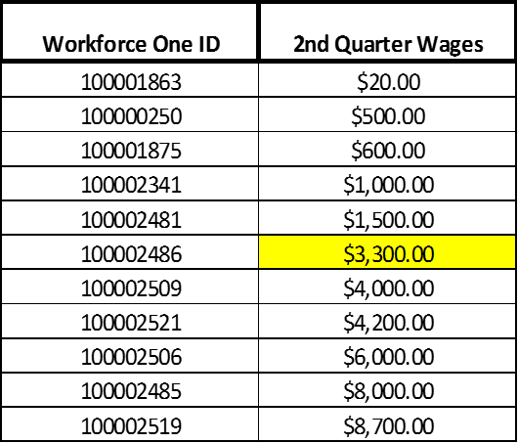
WIOA Performance Indicators (Continued)
Performance Measure | Calculation | Included | Activity in WF1 that triggers performance
Median Earnings | See Below | Total quarter wages for each participant showing wages in the 2nd quarter after exiting except for those exited with exclusion | Any WF1 Activities

Slide 33
WIOA Performance Indicators (Continued)
Performance Measure | Numerator | Denominator | Activity in WF1 that triggers performance
Credential Attainment (Post-Secondary) | Credential was captured in WF1, Attainment date was during enrollment or within 1-year of exit, AND the type of credential attained is recognized | Date of exit is within reporting period AND was enrolled in "Post-Secondary" except those exited with exclusion | Apprenticeship, Classroom Training, Credential Attained without Training, Entrepreneurial Training, and GED training if the GED student exits to employment, Incumbent Worker Training, Occupational Skills Training, Prerequisite Training, Remedial Training, TAA Apprenticeship

Slide 34
WIOA Performance Indicators (Continued)
Performance Measure | Numerator | Denominator | Activity in WF1 that triggers performance
Measurable Skills Gain | Documented increase of functioning level, transcript, report card, milestone, or skills progression during reporting period | All participants enrolled in training leading to a recognized postsecondary credential or employment except those exited with exclusion. It encompasses all WIOA training, OJT, Apprenticeship, and Customized Training | Apprenticeship, Classroom Training, Credential Attained without Training, Customized Training, Entrepreneurial Training, GED Training, Incumbent Worker Training, Incumbent Worker Credential Waiver, Occupational Skills Training, OJT, OJT - Public or Private, Prerequisite Training, Remedial Training, TAA Apprentice

Slide 35
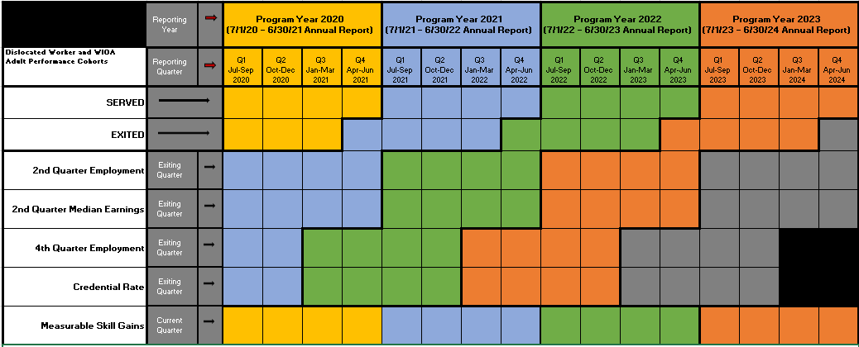
PY20, PY21, PY22, & PY23
WIOA Cohorts
See next couple of slides for directions on how to use this chart

Slide 36
Using the Cohort Chart
Finding Program Year (PY) Timeframes
The top colored section lists four program years in separate colors and the date range included in each of those program years.
PY20: yellow, PY21: blue, PY22: green, and PY23: orange
Example: If you want to know what months are included in PY22, look at the top section in green. This section tells you PY22 runs July 2022 - June 2023.
Finding Quarter (Qtr) Report Timeframes
The second colored sections separates each program year into that program year's quarter report date ranges.
Quarter 1: Jul-Sep, Q2: Oct-Dec, Q3: Jan-Mar, and Q4: Apr-Jun
Example: If you want to know what months are included in PY22 Quarter 1, look at the second colored section under the PY22 label (in green) then find the first Quarter listed (on the left). This tells you PY22 Q1 runs July 20222 - June 2022.

Slide 37
Using the Cohort Chart (Continued)
5 Performance Indicators Measured in every Quarter and Annual report
The far-left section in the chart lists these five Indicators
2nd Quarter Employment: based on the participants’ exit date and employer reported state and national wages in the 2nd quarter after exiting
2nd Quarter Median Earnings: based on the participants’ exit date and the median wage reported by employers (state and national wages) in the 2nd quarter after exiting
4th Quarter Employment: based on the participants’ exit date and employers reporting state and national wages earned in the 4th quarter after exiting

Slide 38
Using the Cohort Chart (Continued)
5 Performance Indicators Measured
Credential Rate: based on all participants who attended training during enrollment and the date the participants exited (4th quarter after the exiting quarter
Measurable Skill Gains (MSG): Only real time measure. Based on all participants who attended training that leads to a credential or employment at any time during their enrollment period and if they have a captured MSG during the reporting period

Slide 39
Using the Cohort Chart (Continued)
To find the date range for exiters included in each Annual Report for all exit based performance indicators
Follow the PY's color in which you want participant exit date ranges on down through the individual indicator section
Once you are in the indicator line you want the information on, look directly up to the quarter date section above it
The quarter date ranges listed above that program year’s color are the exit date ranges that indicator uses
Examples: PY22's 2nd Qtr Employment performance outcome includes participants exited July 2021 - June 2022. PY22's 4th Qtr Employment performance outcome includes participants exited January 2021 - December 2021.

Slide 40
Using the Cohort Chart (Continued)
To find the date range for exiters included in each Quarter Report for all exit-based performance indicators
Follow the PY's color for the quarter in which you want date ranges on down to the individual indicator section
Once you are in the indicator line, look directly up from the PY colored quarter section you want to know to the dated quarter section above it
The quarter date range listed is the exit date range used for that indicator in that program year’s quarter
Examples: Quarter 1 of PY22's 2nd Qtr Employment performance outcome includes participants exited July 2021 - September 2021. Q1 of PY22's 4th Qtr Employment performance outcome includes participants exited January 2021 – March 2021.

Slide 41
Using the Cohort Chart (Continued)
Reminder: The Measurable Skill Gains Performance Indicator is a Real-Time Measure
Denominator: Includes all participants who attended training at any time during the actual program year (had a training activity open at least 1 day)
Numerator: Measures all those participants who have a skill gain captured in WF1 during each program year they had a training activity open on the case
The timeframe used in this indicator is the same timeframe for each Program Year the indicator is measuring
Examples: PY22's Measurable Skill Gains date range includes participants who attended training July 2022 - June 2023. PY22's Q1 Measurable Skill Gains date range includes participants who attended training July 2022 - Sept 2022.

Slide 42

Performance
Questions?
Amy Carlson
State Program Administrator Coordinator
amy.carlson@state.mn.us

