Slide 1

2020 DEED STATE G.O. BOND GRANT
IMPLEMENTATION GUIDE November 2020
WELCOME!
https://mn.gov/deed/

Slide 2
Grant Introduction
Congratulations! Your community has been assigned funding through a bonding bill that was recently signed into law by the Governor
This presentation will cover the most important and most frequently encountered elements related to the Special Appropriations process
Review your project and review the grant dollar amount. The web address for the legislation (Minnesota Session Laws - 2020, 5th Special Session, Chapter 3) starts on Article 1, Section 21 and is:
https://www.revisor.mn.gov/laws/2020/5/Session+Law/Chapter/3/

Slide 3
Grant Introduction (Continued)
DEED and the Minnesota Department of Management and Budget (MMB) each play significant, but different, roles in helping you move your grant project ahead
The Department of Administration’s State Architect and other state entities could also have project roles; including providing required approvals

Slide 4
Pre Grant Application Information
Read MMB’s “After the Bonding Bill.” The web address is:
https://mn.gov/mmb-stat/debt-management/Capital%20Projects/After-the-Bonding-Bill/2020/After-the-Bonding-Bill%20-2020%20Final%20%28002%29.pdf
FYI – MMB plans to update “After the Bonding Bill” Soon, so the link may change
Then read MMB’s “Capital Grants Manual.” The web address is:
https://mn.gov/mmb-stat/debt-management/Capital%20Projects/Capital%20Grants%20Manual/Capital%20Grants%20Manual%202017.pdf
The Project must have a Public Purpose, Public
Ownership, and Public Oversight

Slide 5

More on Capital Grants Manual – Your Best Reference Guide

Slide 6
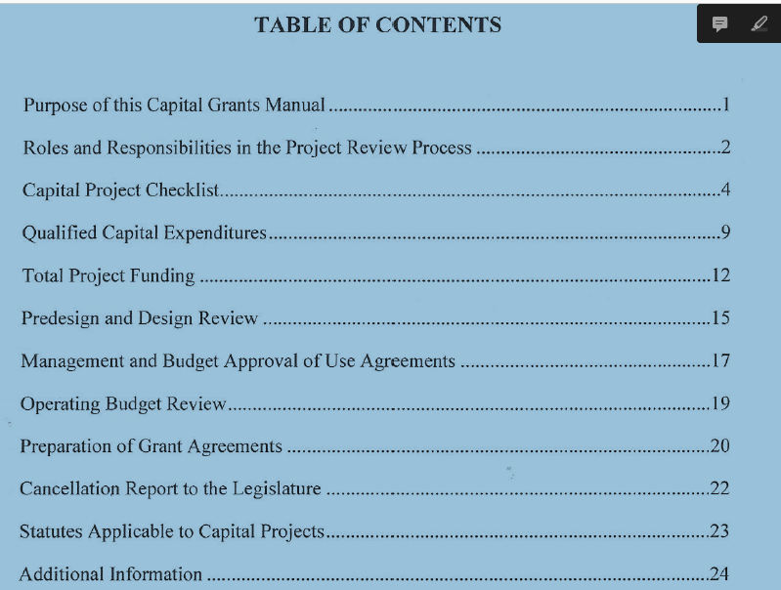
Capital Grants Manual

Slide 7
Pre Grant Application Information (Continued)
DEED will work through the Grantee, not any possible counterparties, to help your community implement and manage the project
Bond Funds can only be used for the specific items included in the grant appropriation language

Slide 8
Very Important Aspects to Remember About
G.O. Bond Grants
THE GRANTEE MUST NOT HAVE BEGUN WORK ON THE PROJECT BEFORE THE BONDING BILL ENACTMENT DATE OR BEFORE RECEIVING PERMISSION FROM DEED. WORK DONE BEFORE ENACTMENT WILL NOT BE REIMBURSABLE WITH GRANT FUNDS, UNLESS THE LEGISLATION ALLOWS IT
AFTER PROJECT COMPLETION, THE USE AND FUNCTION OF THE PROJECT CANNOT CHANGE OVER ITS USEFUL LIFE WITHOUT REPAYMENT TO THE STATE
The grantee must enter into a grant agreement with DEED by 12/31/24 or else the appropriation will be canceled

Slide 9
Grant Application information
DEED will provide a Special Appropriation Grant application form tailored to the nature of the project
The application will have to be fully completed, accepted and approved by DEED

Slide 10
Grant Application Information (Continued)
The application will include a budget, roles and contact information, project timeline, narrative, and some basic questions
The budget will include sources and uses and will ultimately be approved by MMB for full project funding

Slide 11
Application Attachments
Pre-Engineering or architectural cost estimate documents
Evidence of property ownership (if in possession at time of application)
Capital Project Checklist From pages 4-7 of the Minnesota Capital Grants Manual (per slide #4) to document project eligibility

Slide 12
Application Attachments (Continued)
Conflict of Interest Disclosure
DEED Provided Local Government Resolution
Site location and zoning maps
Photos (if applicable)

Slide 13
Implementation Process
After the application has been submitted and accepted, the implementation process would begin
The implementation process is outlined in the upcoming slides
It is important that the grantee actively administrate the project

Slide 14
Other Implementation Requirements
Project must be competitively procured (local bidding follows state standards)
Project is or would be properly insured
Use of debarred, suspended or ineligible contractors is prohibited
State prevailing wage standards apply
Certificate of Occupancy or building inspector sign-off (if applicable)

Slide 15
Implementation - Full Project Funding
As mentioned, Minnesota Management and Budget (MMB) must approve full project funding to ensure that all necessary financing is secured and in place
Roger Behrens of MMB at 651-201-8131is the person to contact to implement the full funding process. Roger.Behrens@state.mn.us

Slide 16
Implementation - Predesign Process
Predesign approval is needed from the State Architect - Minnesota Department Administration - for projects (generally buildings) with total construction costs of $1.5 million or more
Some projects are exempt from predesign submittal and approval. The web address for the statute that outlines them is: https://www.revisor.mn.gov/statutes/cite/16B.335

Slide 17
For More Predesign Information
The predesign manual can be located at this web address: https://mn.gov/admin/assets/RECS-CS-Predesign-Manual--6th-Edition_tcm36-208484.pdf
The contact at the State Dept. of Administration for predesign is Bee Yang at 651-201-2393
bee.yang@state.mn.us

Slide 18
Implementation - Design Process
Projects that have received predesign approval are required to submit the project’s design to the chairs and ranking minority members of the Senate Finance and Capital Investment Committees and the House Capital Investment and Ways and Means Committees for approval
DEED would provide grantees with the required legislators names when the exercise becomes necessary
https://www.revisor.mn.gov/statutes/cite/16B.335 is the web address for more information on the design process

Slide 19
Implementation - Use/Lease Agreements
The Minnesota Office of Management and Budget (MMB) would need to approve Use/Lease Agreements if they apply to the project
Required if the project would be operated by an entity (whether public or private) other than the public entity receiving the grant
May apply if the project would be frequently used by one or more entities

Slide 20
Grant Contract Agreements
A fully signed Grant Contract Agreement must be in place before any grant Reimbursement Payment Request (RPR) can be submitted, reviewed and considered for payment by DEED
Grant funds would not be available to the Grantee until necessary contract elements are satisfied (including the Grant Contract Agreement Section “Conditions Precedent to any Advance”)
Grantee Representatives need to be fully conversant of all elements of the Grant Contract Agreement

Slide 21
Grant Contract Agreements (Continued)
All Amendments and Revisions must:
  Be justified by extreme extenuating circumstances
  Be requested in writing at least 30 days prior to the end date of the grant – and prior discussions with the DEED Authorized Grant Representative should have occurred as well

Slide 22
More Requirements - DEED Would Need Before Providing Funds
Recorded Declaration or Waiver from the Declaration from MMB (Roger Behrens) obtained (to secure DEED interest in the property)
Current operating budget submitted to DEED, plus 2 years projected budgets to ensure project can run and function as intended

Slide 23
Requirements Before DEED Would Provide Funds (Continued)
All necessary permits must be current and in place
General Contractor Payment/Performance Bond is required and adequate
People operating the completed project and the facility itself have proper certification and licensing (if applicable)

Slide 24
Administrative Costs
Non-bondable administrative costs are not allowed as an eligible bond expense and are not considered part of the project
Grantee staff time of any kind is not an allowable expense

Slide 25
Reimbursement Payment Requests
  DEED would prepare a grant specific RPR form and provide it to the Grantee. If applicable, the RPR would also outline match requirements
  DEED does not prepay any grant expense and operates by reimbursing incurred costs
  RPRs can be submitted by the Grantee to DEED twice a month (Slide #28) using the DEED RPR form (Slide #27)

Slide 26
Reimbursement Payment Requests (Continued)
  RPRs must be accompanied by a Summary of Expenses utilizing line items that match the RPR line budget items and corresponding receipts and/or invoices
  DEED grant budget lines on the RPR’s can not be exceeded and all costs must be bond eligible
  RPRs should be scaled in order to exhaust grant funds when project is complete as DEED will not pay out final funds until the project is complete, fully monitored and a final report has been submitted

Slide 27
Notes:
Here is a sample reimbursement payment request form. The form self-calculates, but remember to carry over new balances to the next pay request that is submitted. DEED staff will help you complete pay requests and it is important to remember that the reimbursement period cannot cross a state fiscal year of June 30 end.

Slide 28
Reimbursement Request – Due Dates

Slide 29
Reporting and Monitoring
Annual reports are required each year and a final report must be submitted when the project is complete. The reports must be completed with DEED provided forms and all funds will not be released until the final report is accepted by DEED
All grants will be monitored (including for financials and on-site if at all possible) at least once over their life. Larger dollar grants will be monitored annually

Slide 30
Summary of Most Important Tasks
Establish an immediate working relationship with DEED staff assigned to project
Request and receive from DEED a Grant Application form
Fully complete and sign that application and return it to DEED
Work with MMB to obtain full funding documentation and approval

Slide 31
Summary of Most Important Tasks (Continued)
If applicable, submit a project design to Legislative Chairs for purposes of notification or recommendation
If applicable, enter into lease/use agreements that are approved by MMB
Submit an operating budget with a two year projection
If applicable, work with the Dept. of Administration for project predesign approval

Slide 32
Summary of Most Important Tasks (Continued)
If applicable, ensure that all licensing to operate the project is in order
Ensure that contractor payment/performance bonds and all necessary permitting are in place and in order
Declaration (or waiver from the Declaration from MMB) and permitting

Slide 33
Thank You!
Thank you for reviewing DEED’s Special Appropriation PowerPoint training. We look forward to working with you as the grantee on this very important project
Additional Communication
Please provide any comments to Gerald.Wenner@state.mn.us or
Patrick.Armon@state.mn.us

