Slide 1
State Rapid Response Team (SRRT)
Dislocated Worker &
Trade Adjustment Assistance

Slide 2
State Rapid Response Team (SRRT) Process Overview
WARN or Layoff Notification- when does RR get involved?
Face to Face Meeting
  Current Situation, Layoff Aversion, Confidentiality
  Dislocated Worker Program, TAA Petition
  Employer Questionnaire
Group Info Meetings-UI
Selection Committee Meetings
RR Handoff

Slide 3
What’s Next?
Formula- Small Layoff Services Broadcast

Slide 4
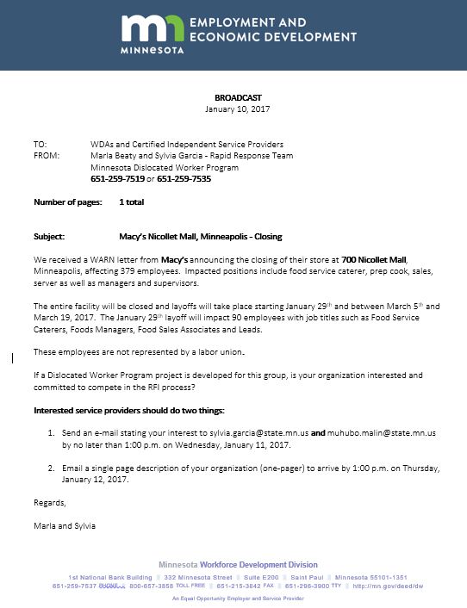
Project
Competitive or Non-Compete?
Broadcast Notice

Slide 5
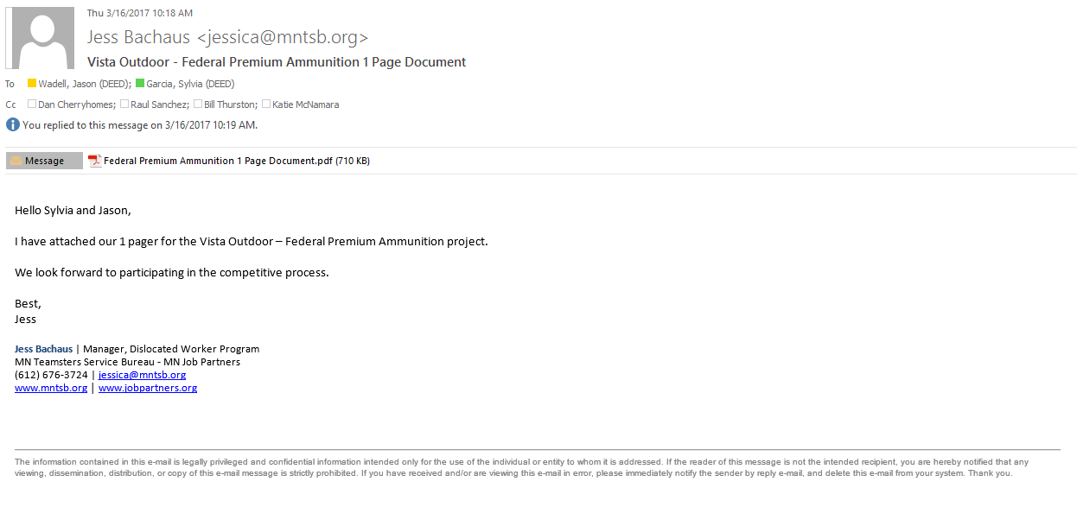
Email Interest Statement

Slide 6
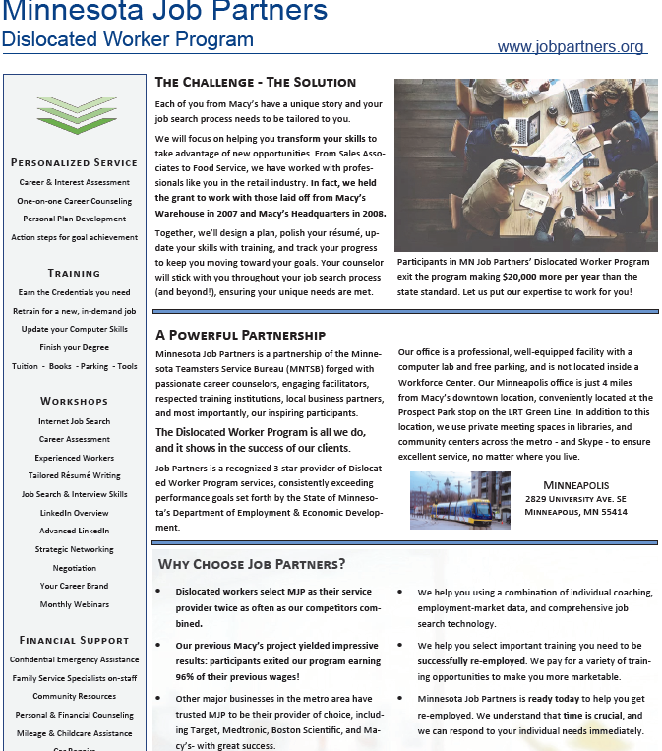
Project “1-Pager”

Slide 7
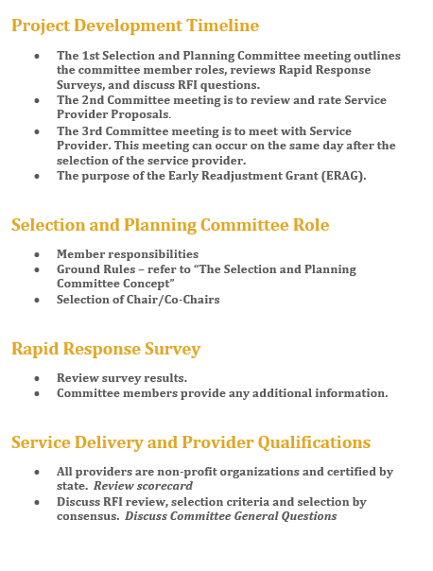
1st Selection Committee Meeting
Overview of Program

Slide 8
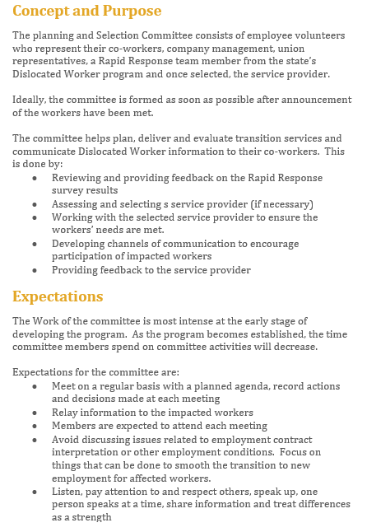
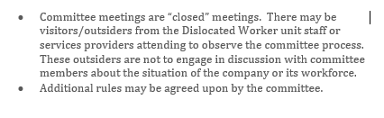
Getting Started

Slide 9
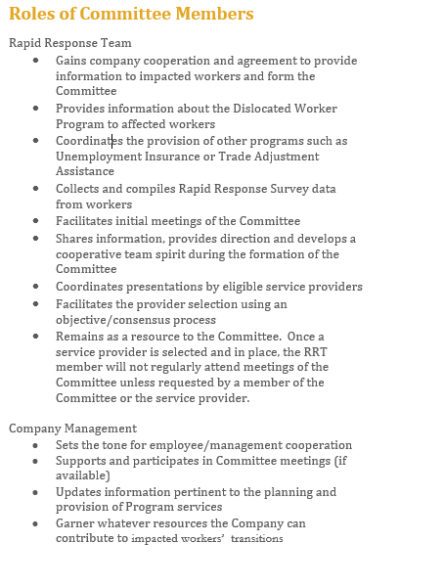
Getting Started

Slide 10
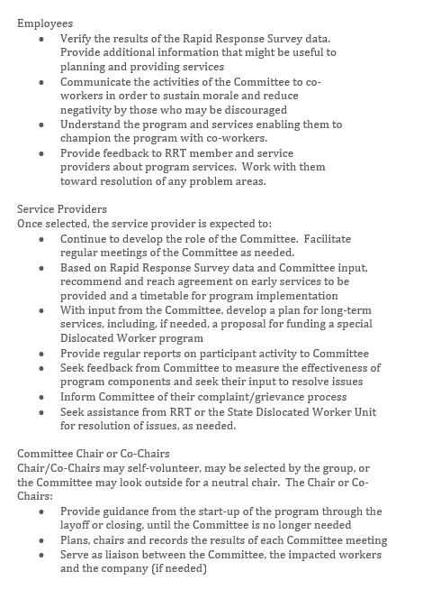
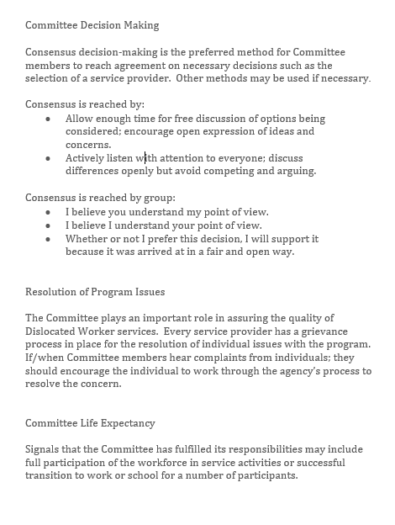
Making It Your Own

Slide 11
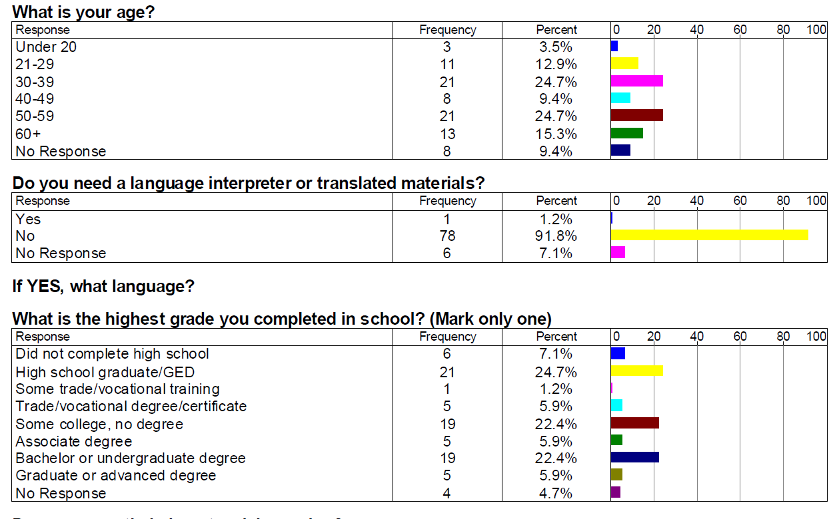
Rapid Response Survey

Slide 12
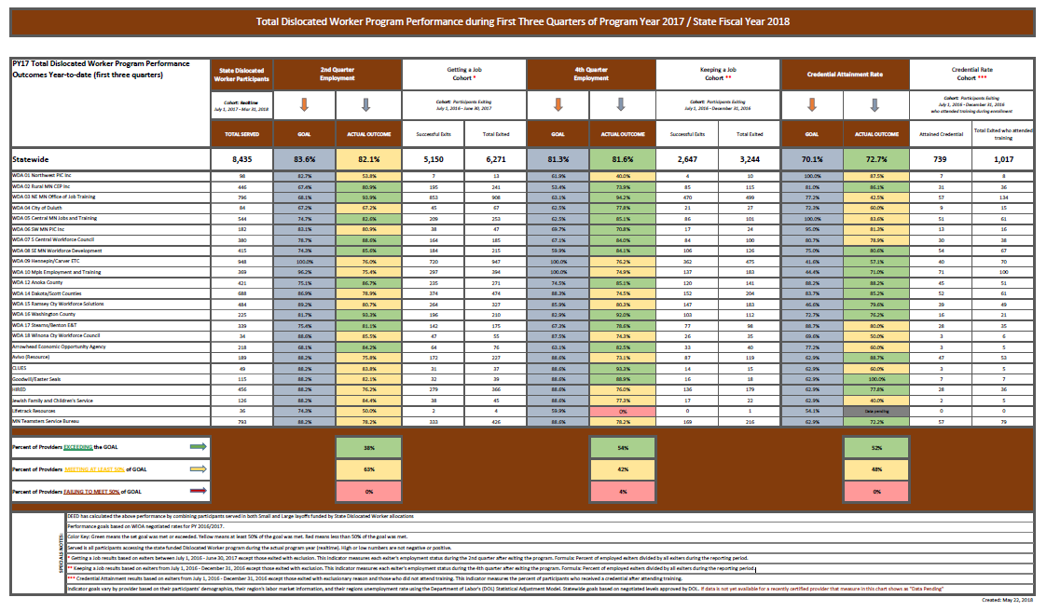
DW Program Performance 2018

Slide 13
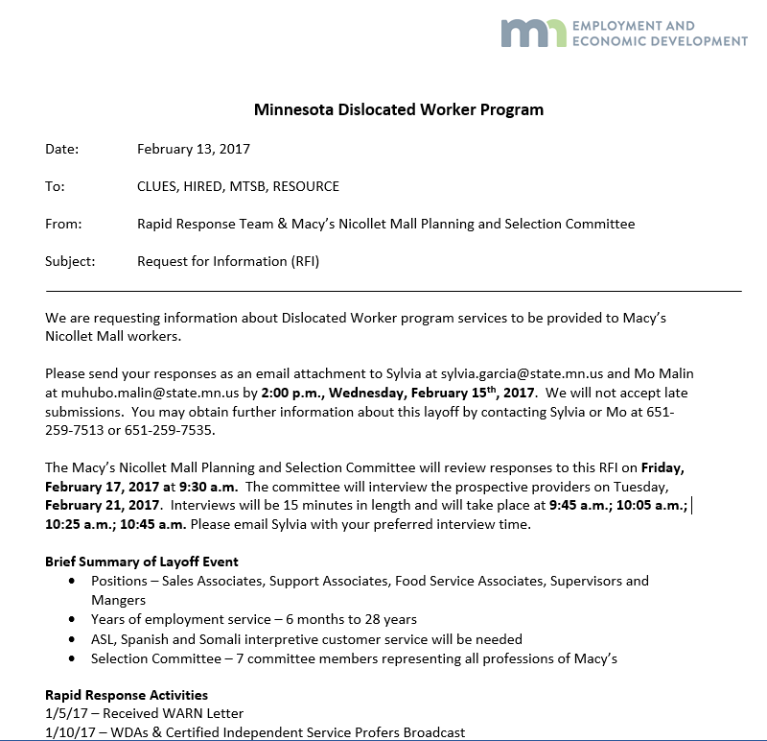
Selection Committee RFI Review

Slide 14
2nd Selection Committee Meeting
Service Provider Proposal Reviews
Capture pros & cons of each provider’s proposal
Rank each provider based on proposals

Slide 15
3rd Selection Committee Meeting
Interview the Service Provider(s)
Capture pro’s and con’s of each interview
Rank each provider based on interview
Choose provider based on ranking of proposals, interviews and consensus vote
Committee meets with selected Service Provider

Slide 16
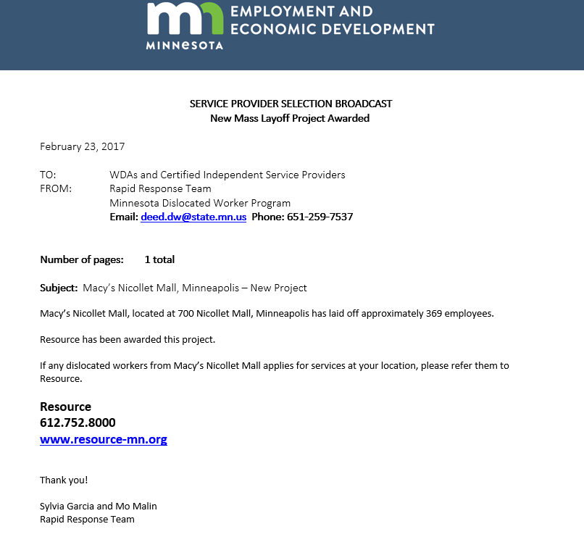
Final Broadcast

Slide 17
Non-Competitive Process Overview

Slide 18
Debrief
TAA & Rapid Response
  Enrollment
  Participation
Questions?
Observations?

Slide 19

Thank you!
Minnesota’s State Rapid Response Team
Jason Wadell, Coordinator, 651-259-7552, jason.wadell@state.mn.us
Marla Beaty, TAA Liaison, 218-259-1380, marla.beaty@state.mn.us
Liz McLoone, Union Liaison, 651-259-7145, liz.mcloone@state.mn.us
Mee Yang, UI Liaison, 651-259-7548, mee.yang@state.mn.us

