Slide 1
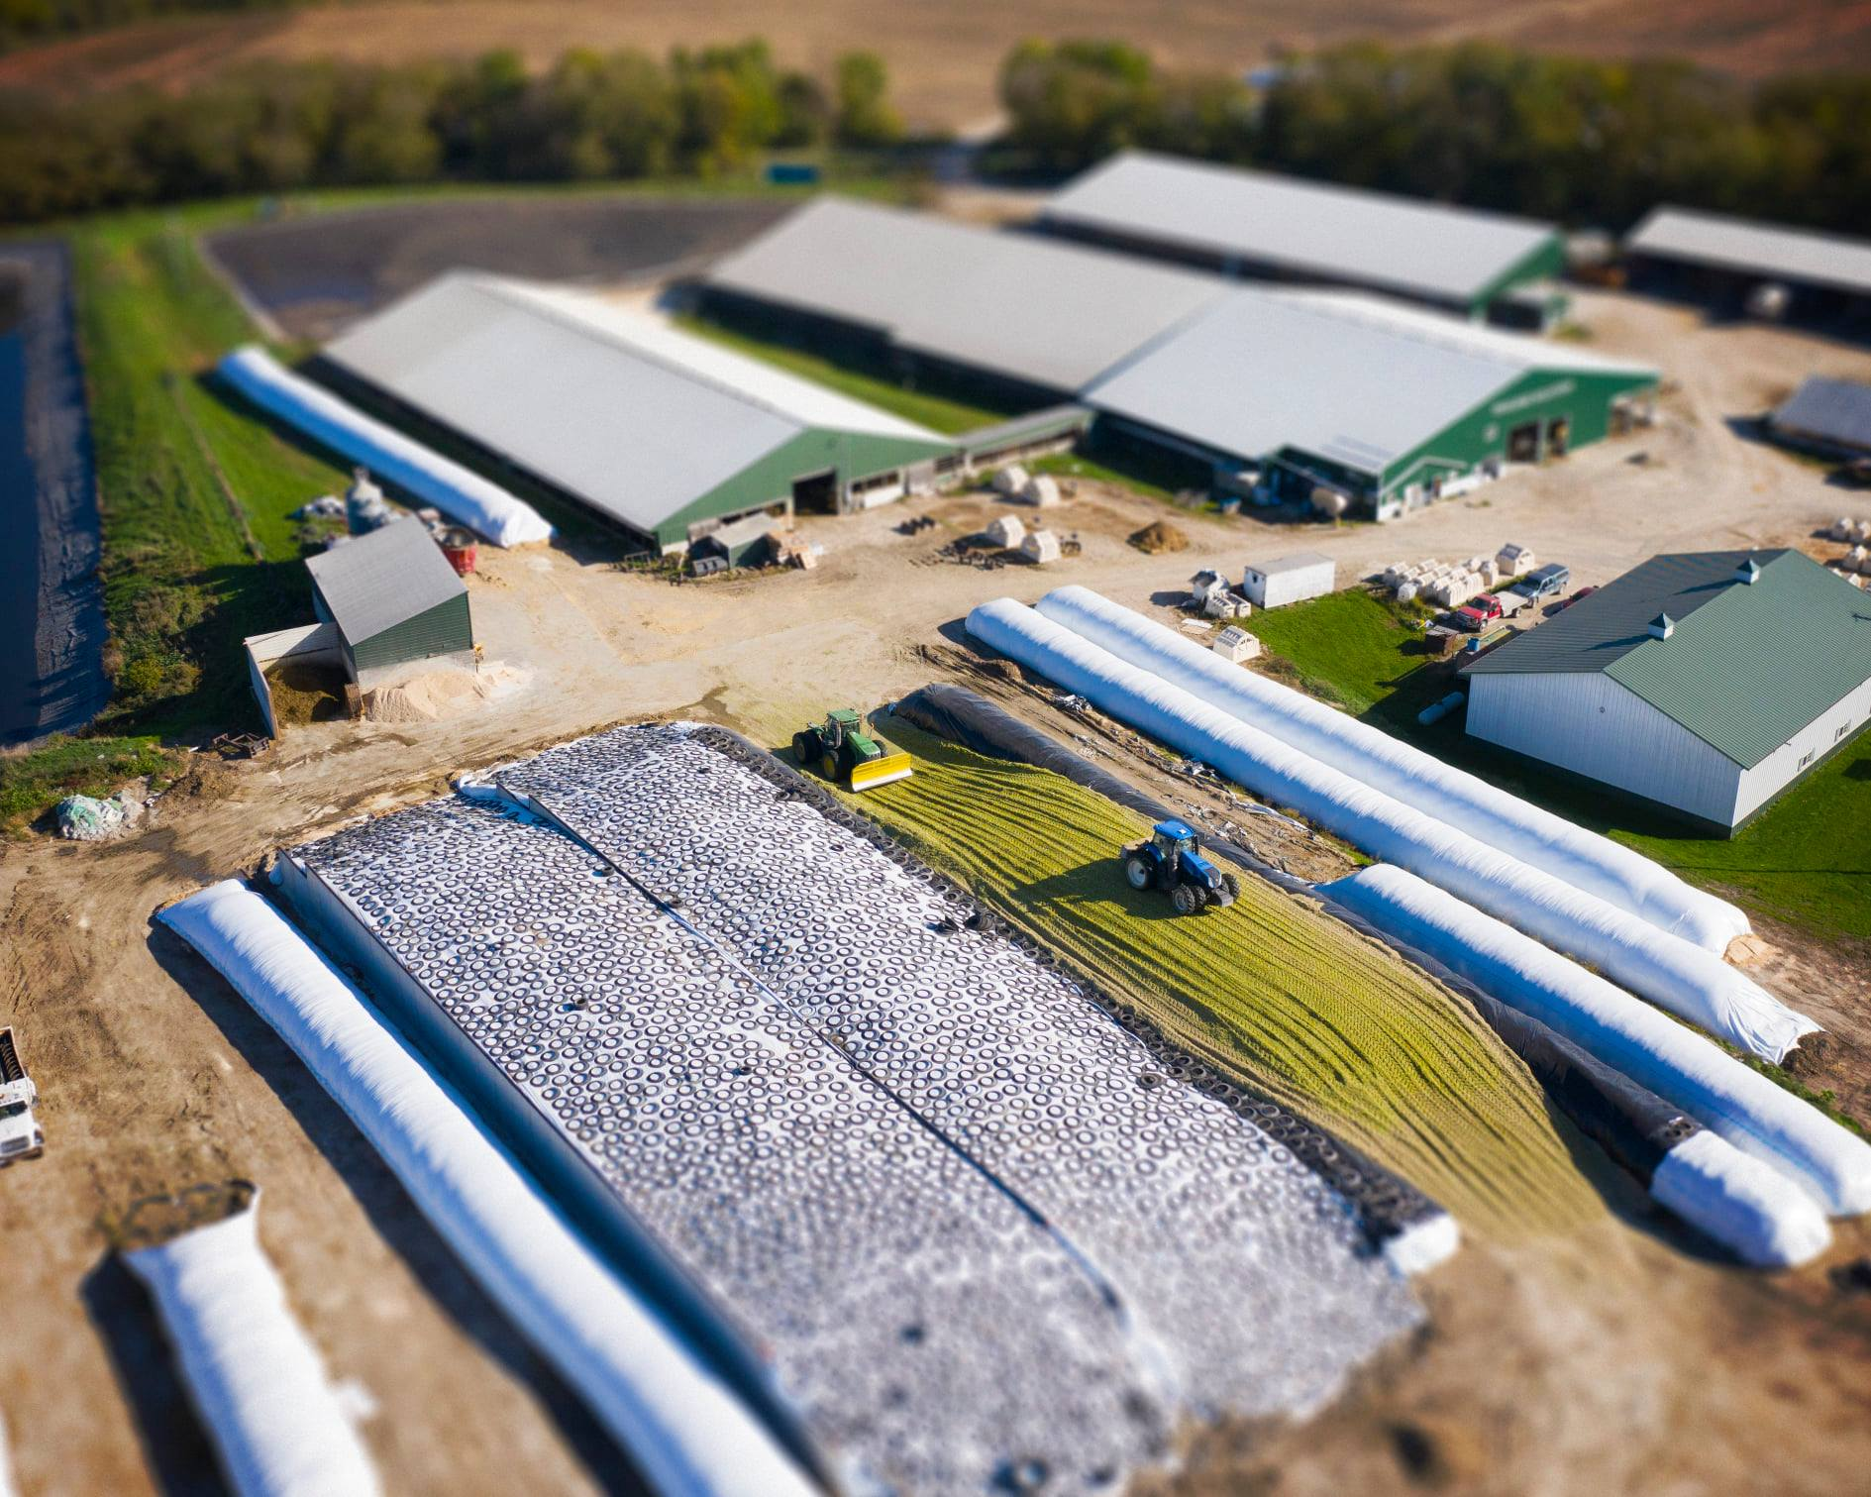
TRAILSIDE HOLSTEINS FOUNTAIN, MN Michael Johnson

Slide 2
Established in 1978
Provide 6,000 gallons of milk daily to Kwik Trip
Began using MiBroadband in 2014
Utilize internet to communicate between 2 sites
Use several management systems that rely on reliable internet connection 24/7

Slide 3
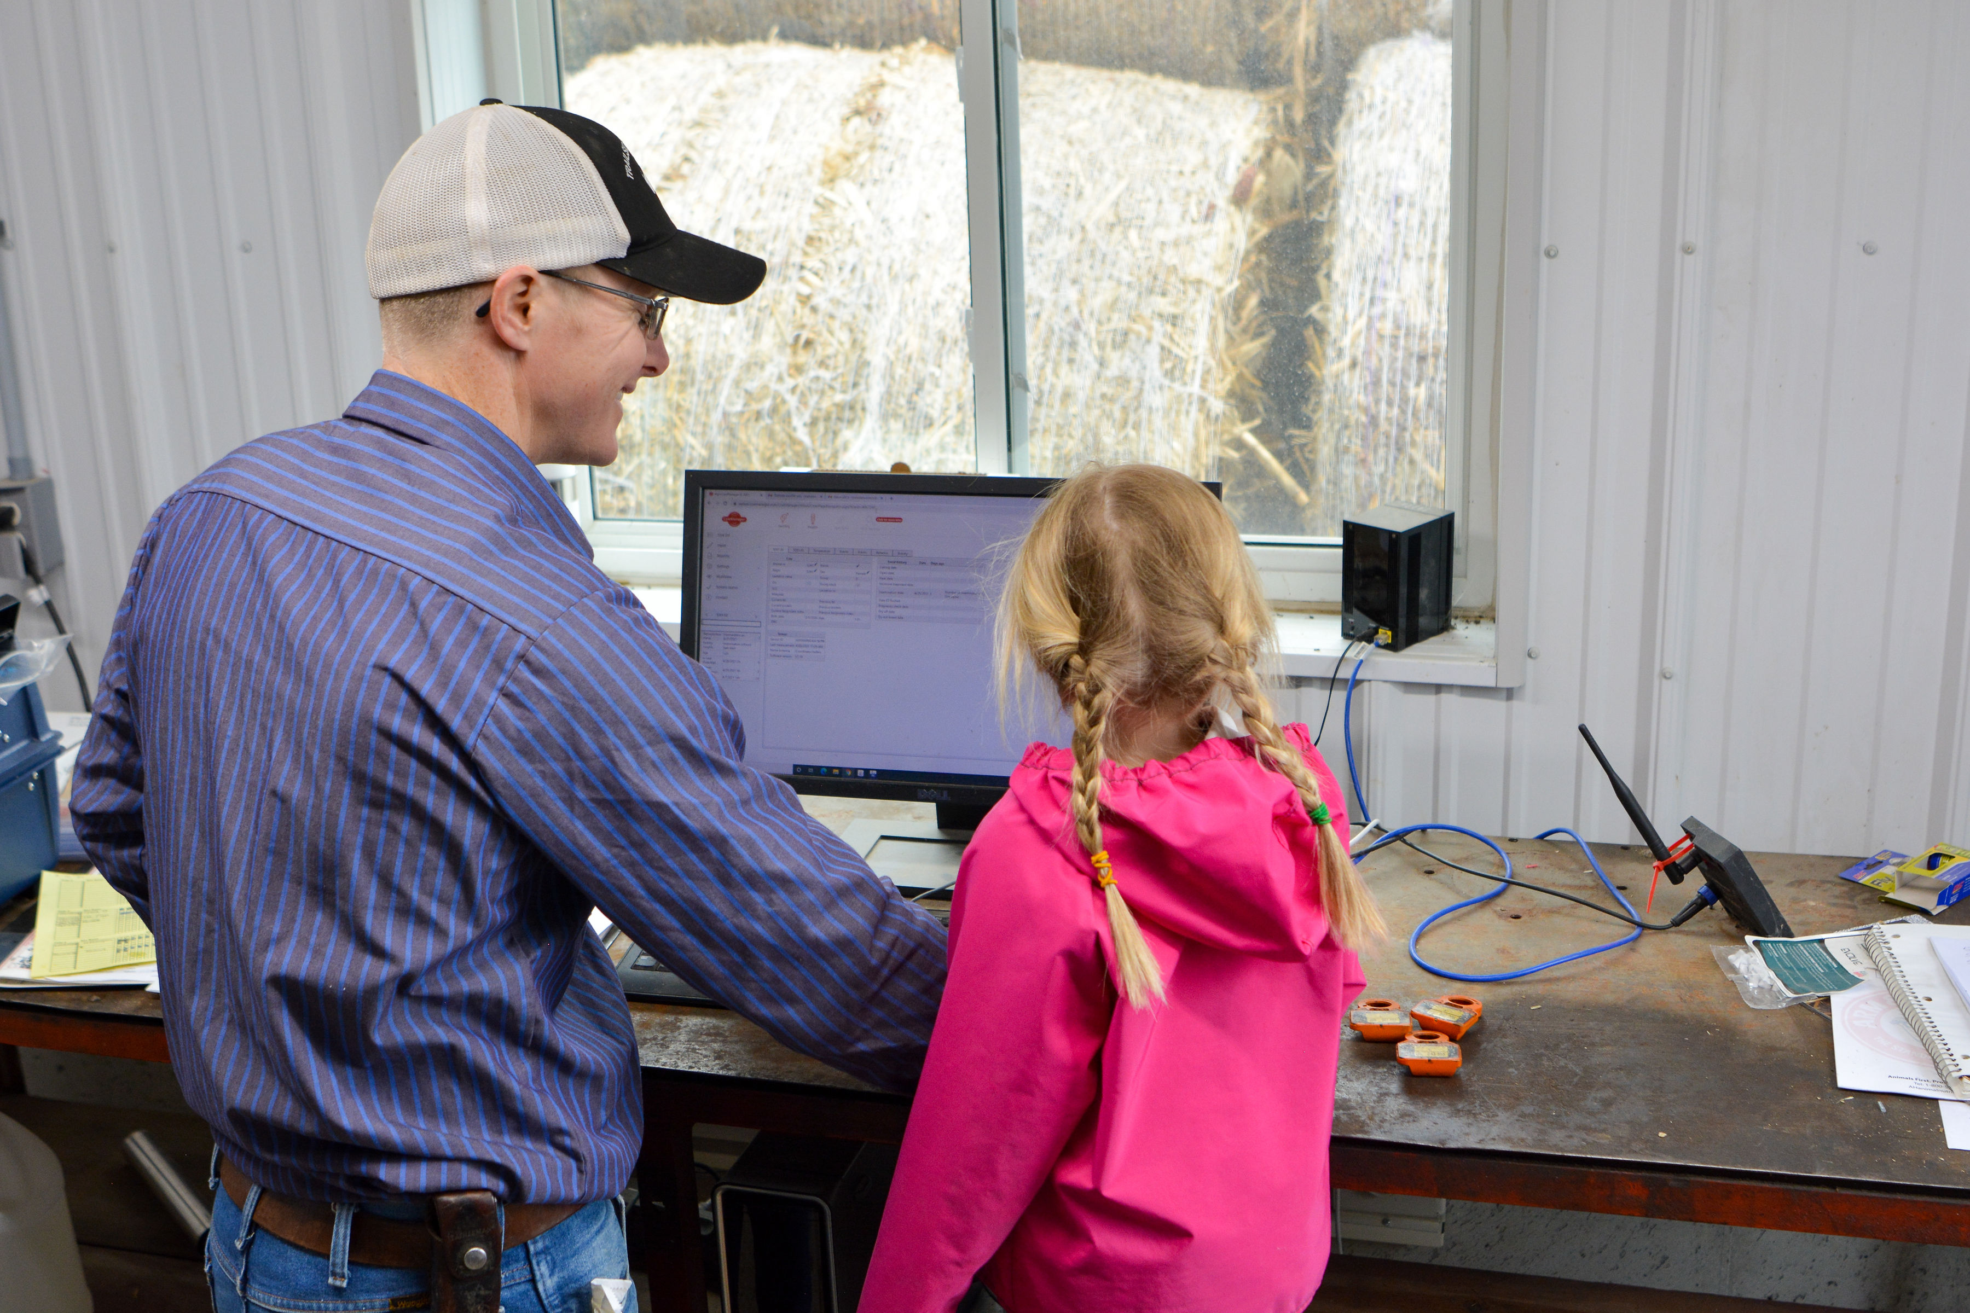
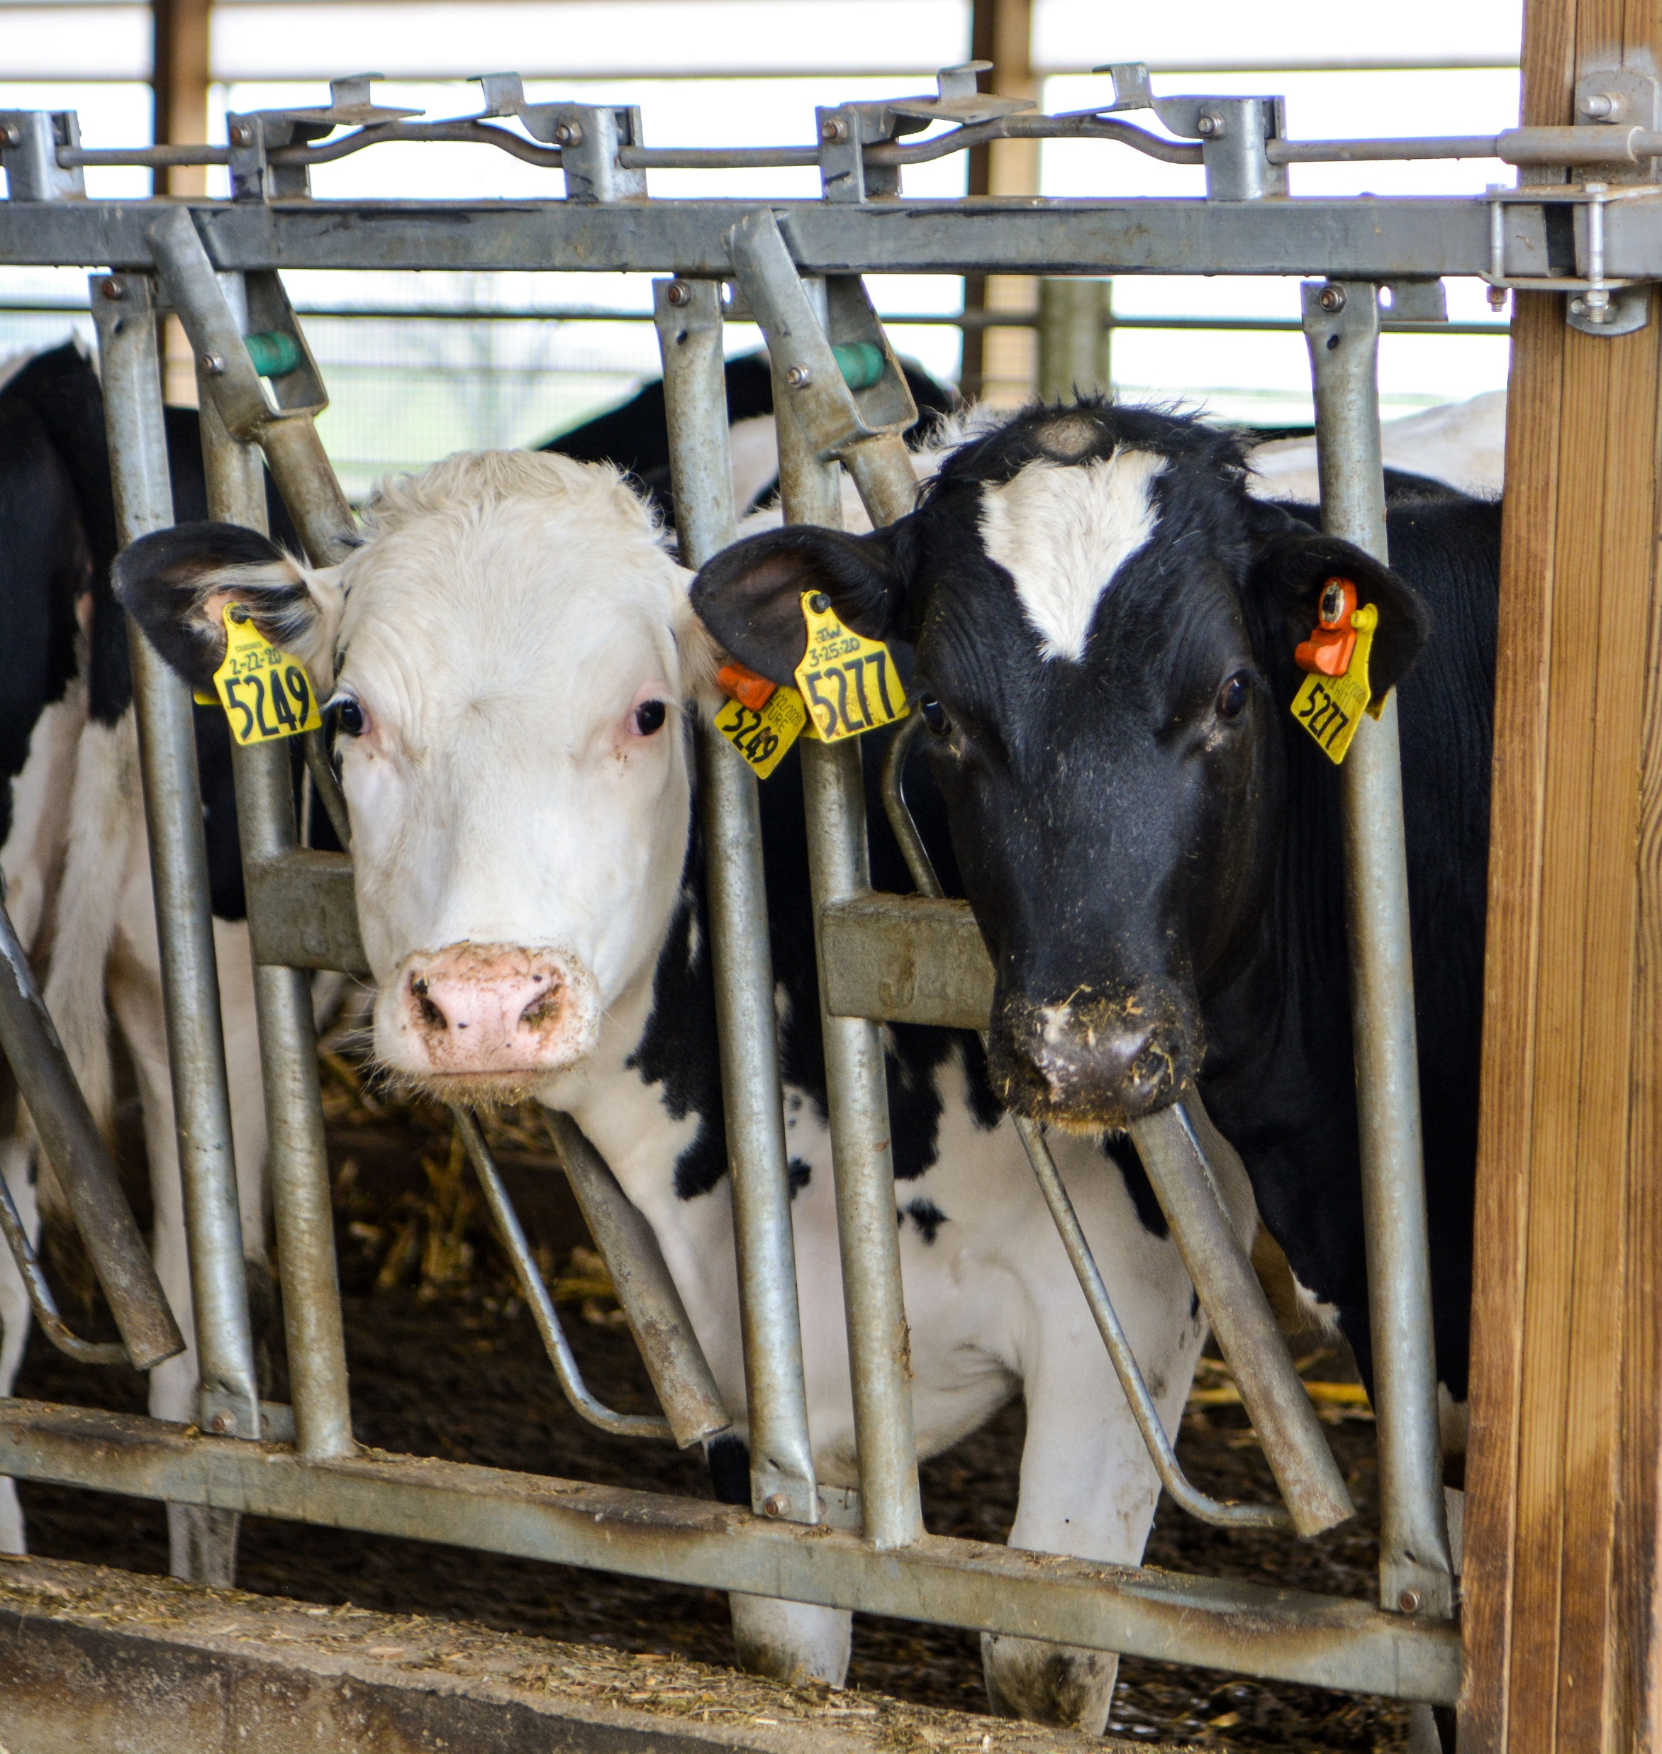

Slide 6
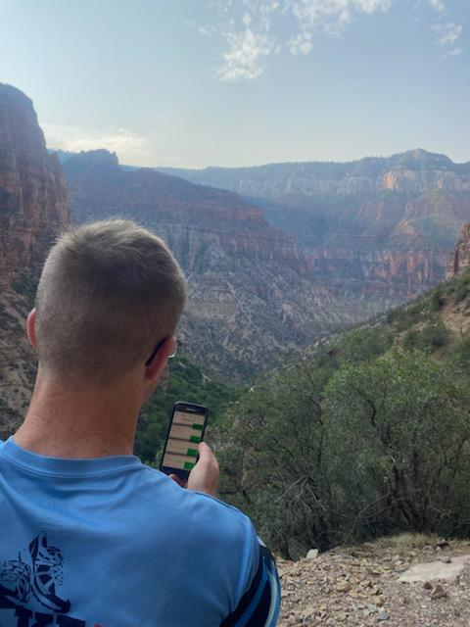

Slide 7
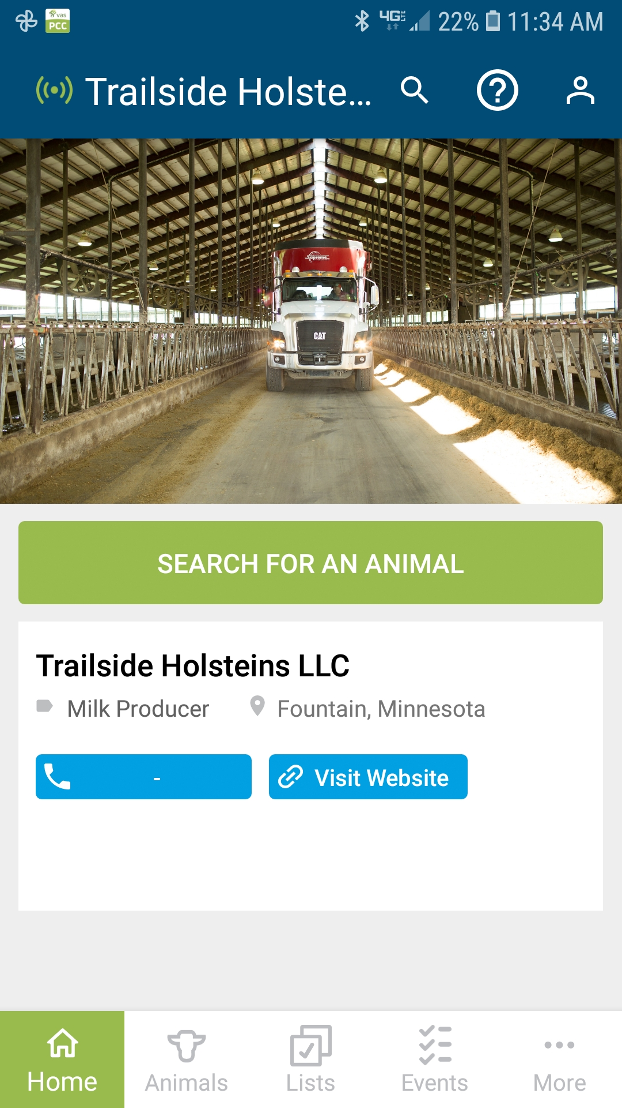

Slide 8
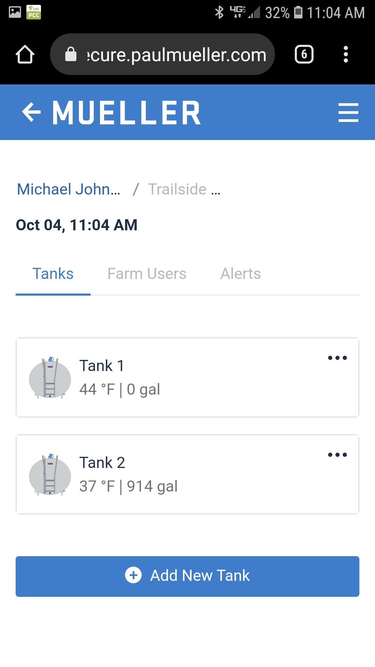

Slide 9
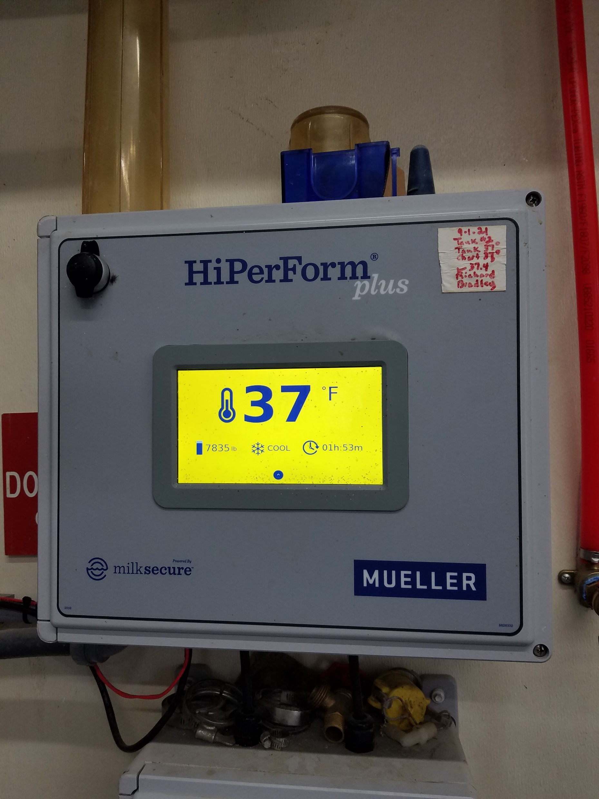

Slide 10
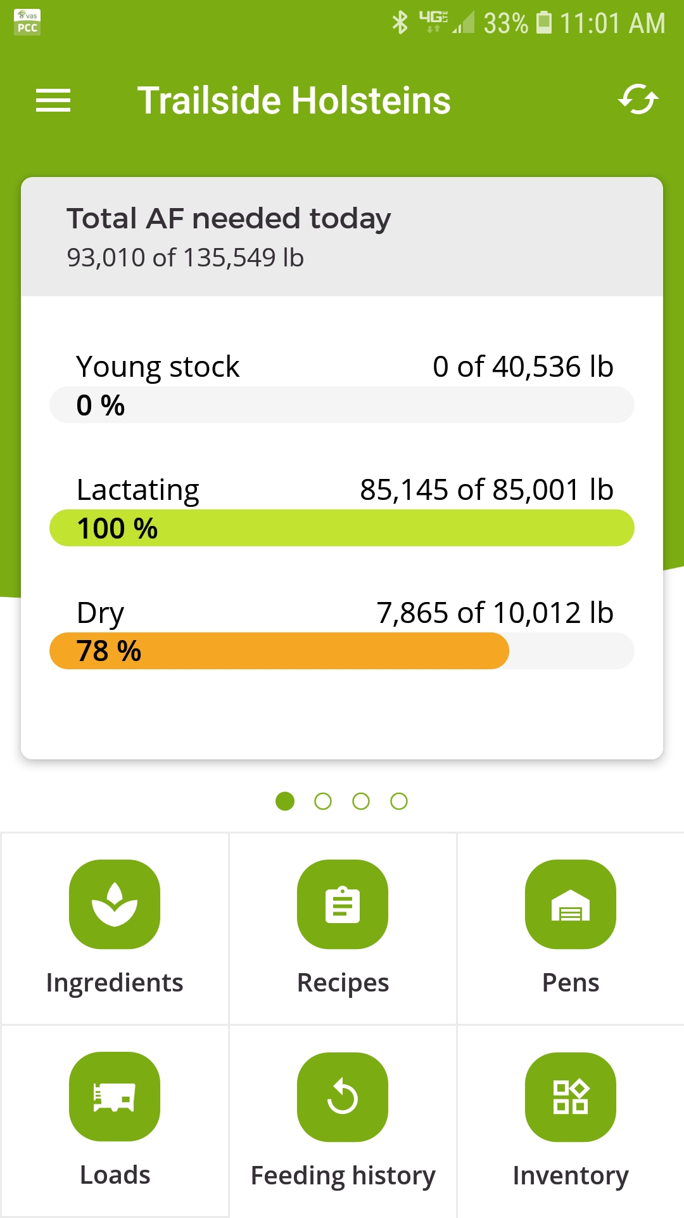

Slide 11
